Slide 1
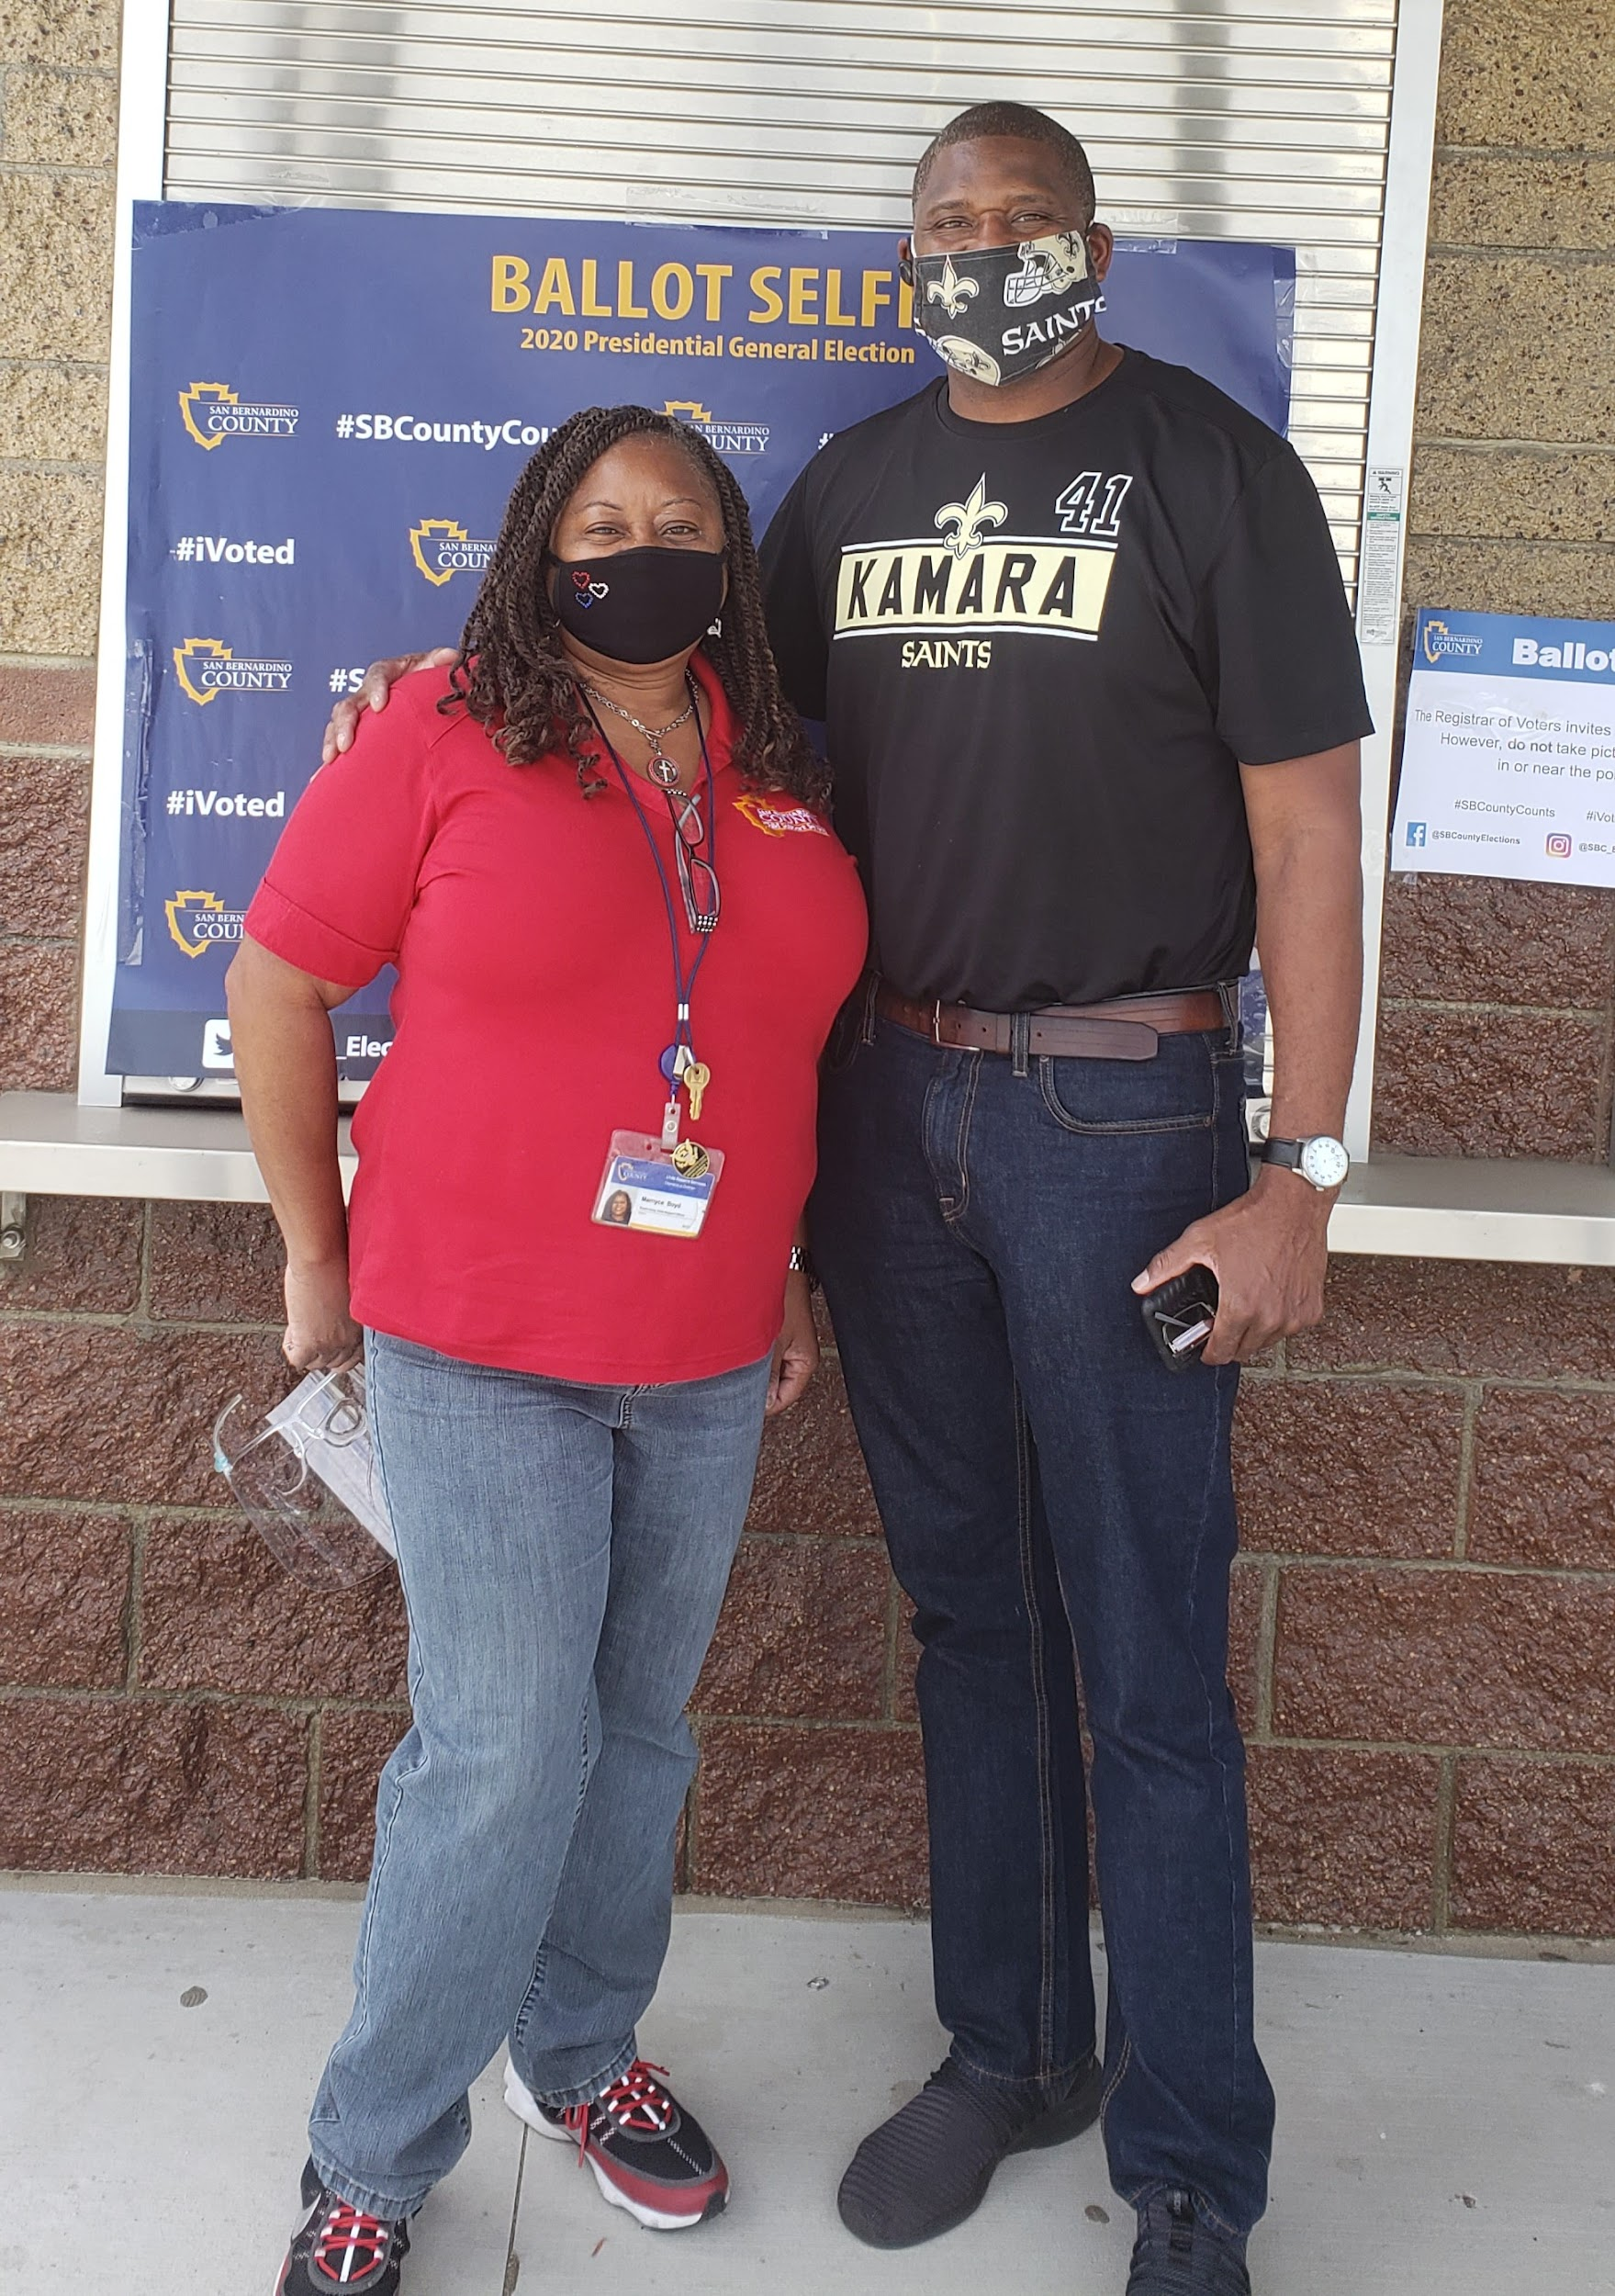
SOCIAL ACTION IS A VERB
SBRAAC • 2020-2021

Slide 2
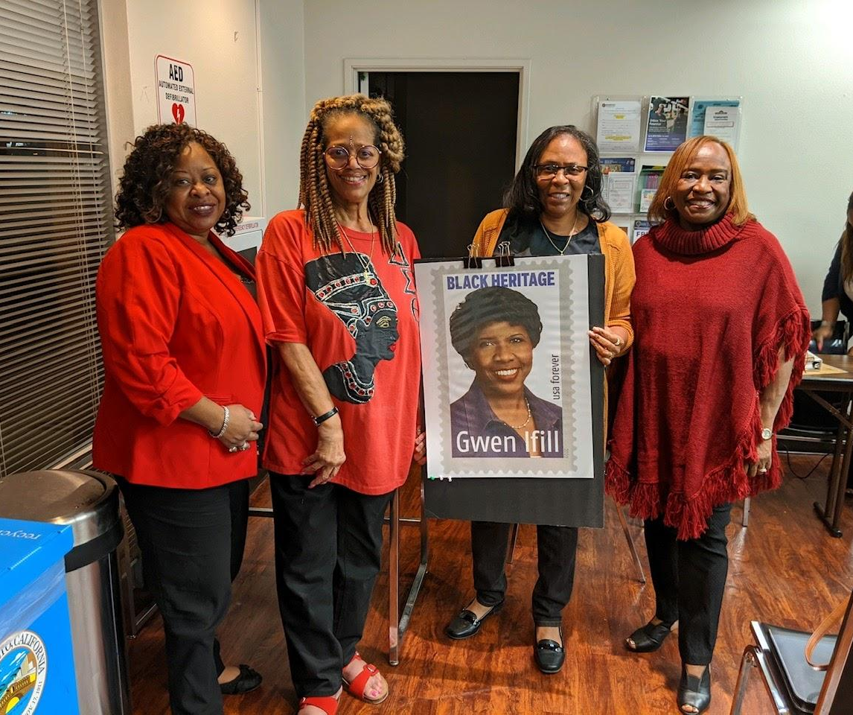
We were trained in conjunction with Heritage and Archives on the Census and advocated for all to be counted!

Slide 3
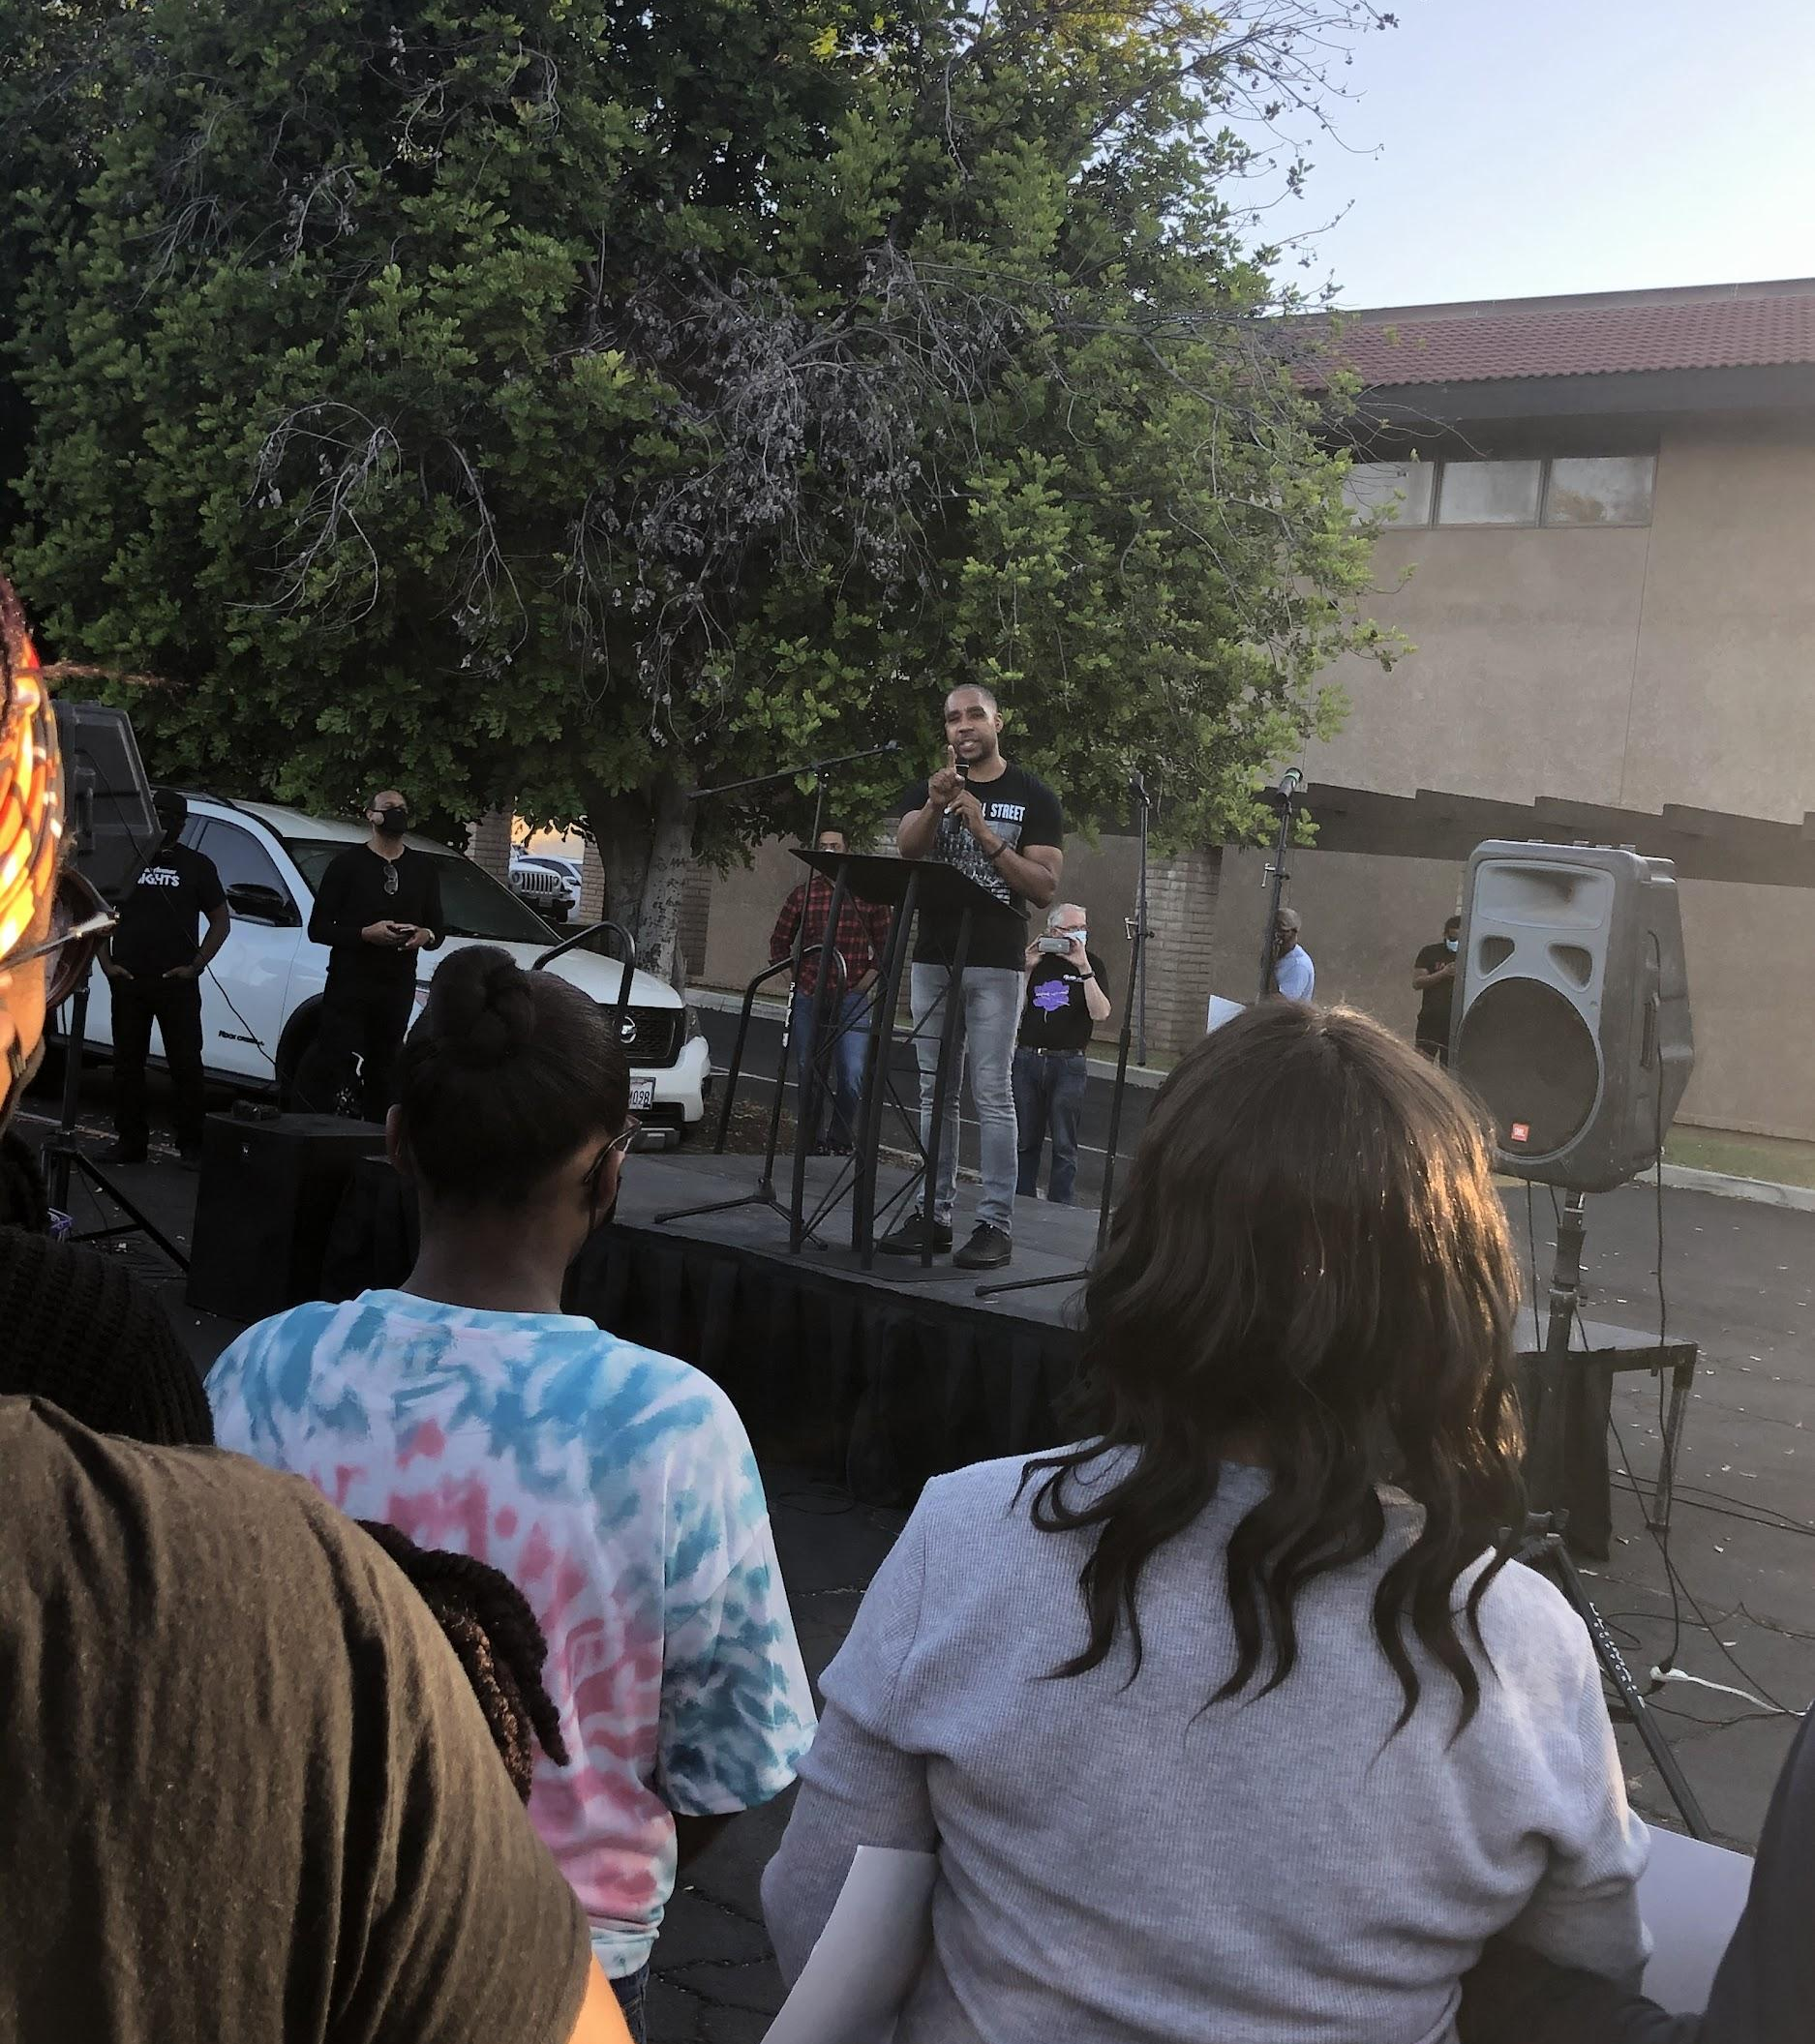
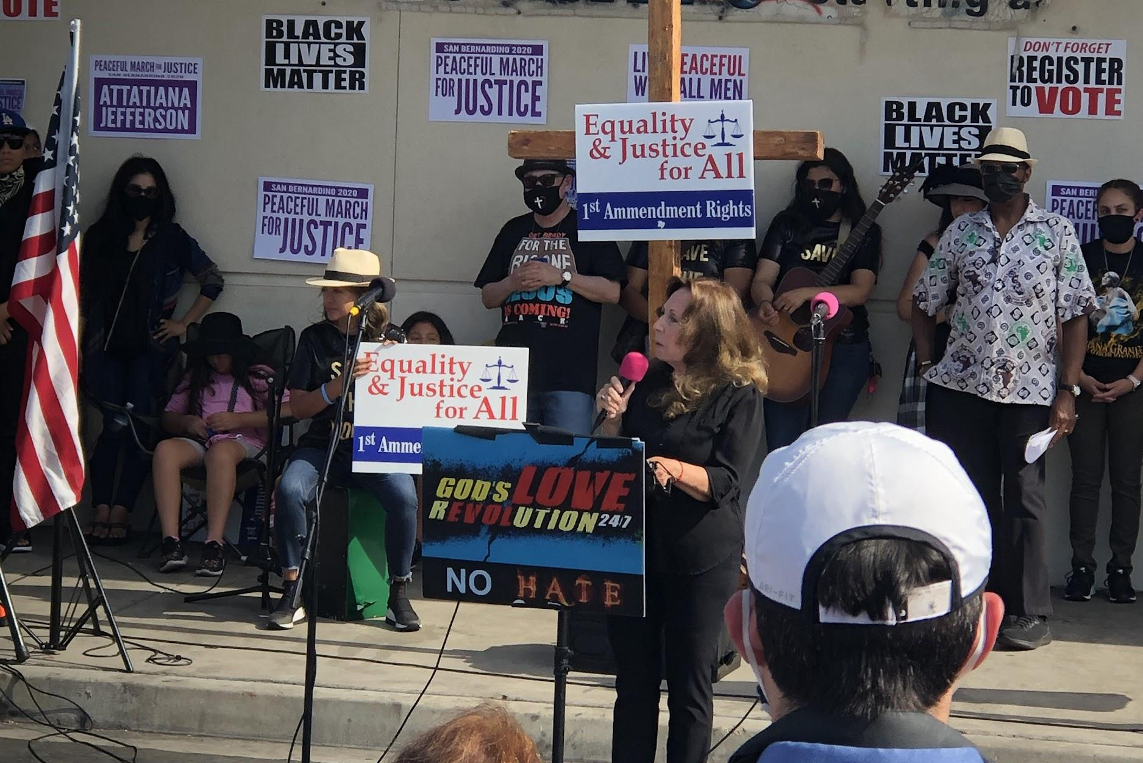
WE SHOWED UP!!!
WE RALLIED!!!

Slide 4
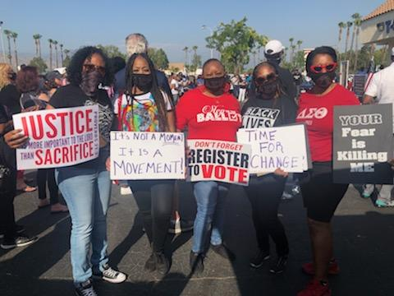
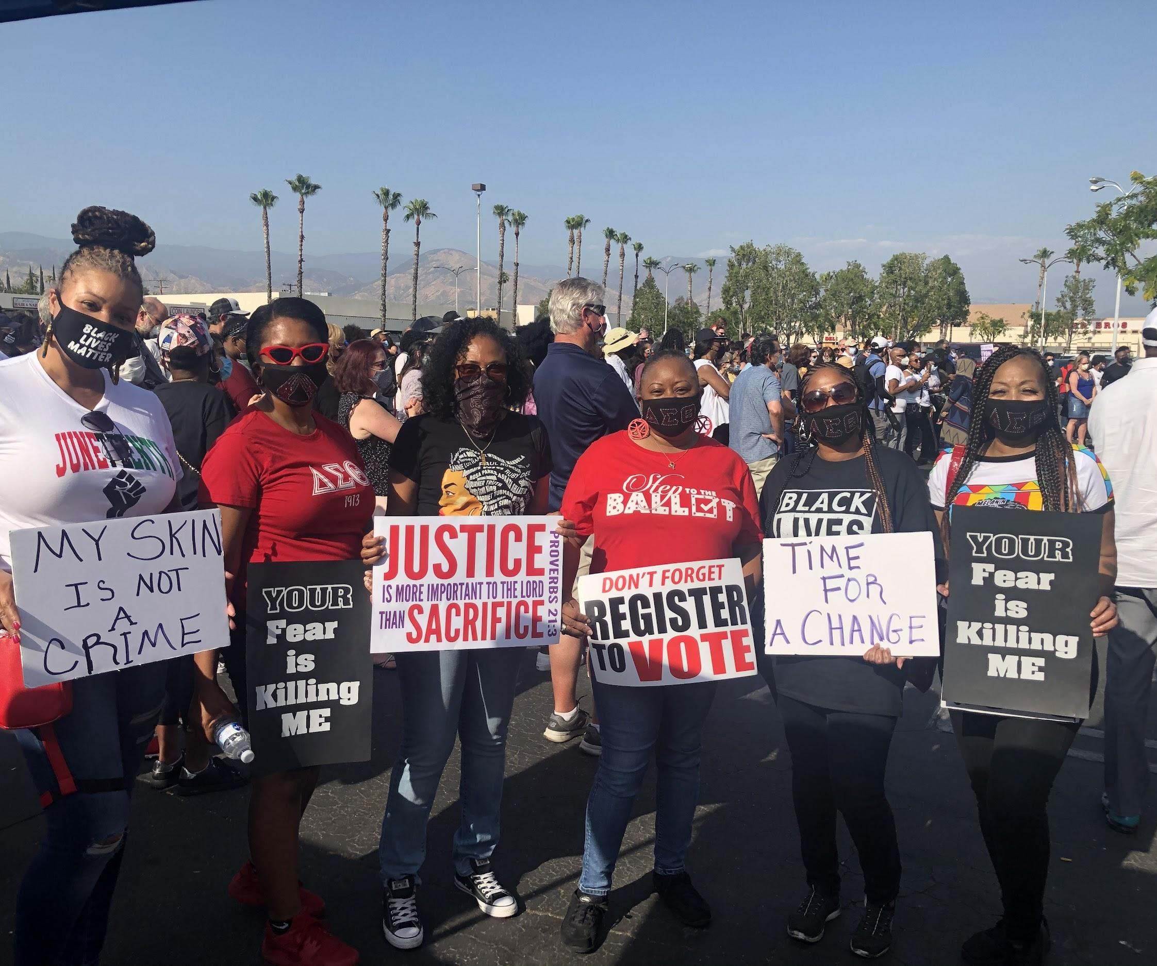
Social Action teamed up with Membership to rally and march for justice.

Slide 5
This

Slide 6
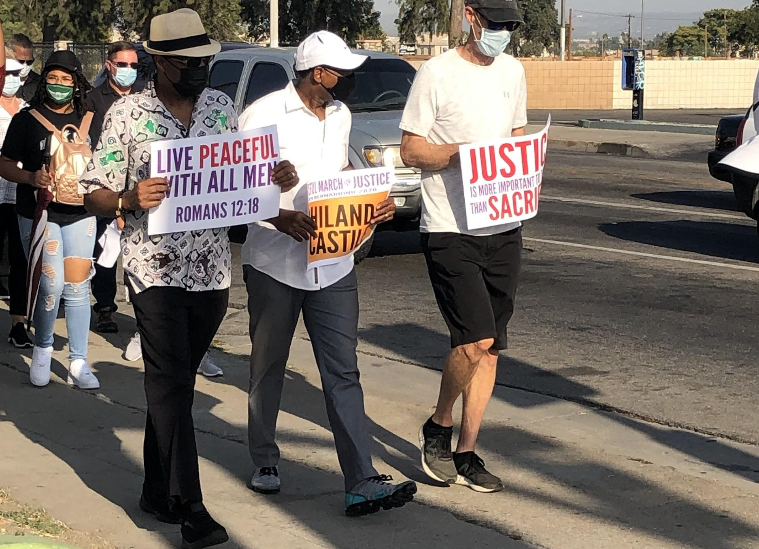
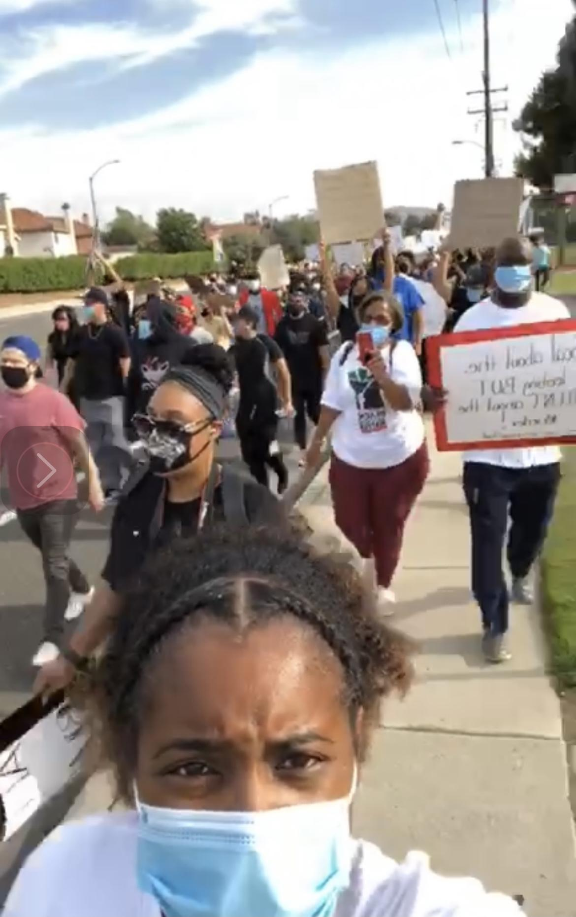
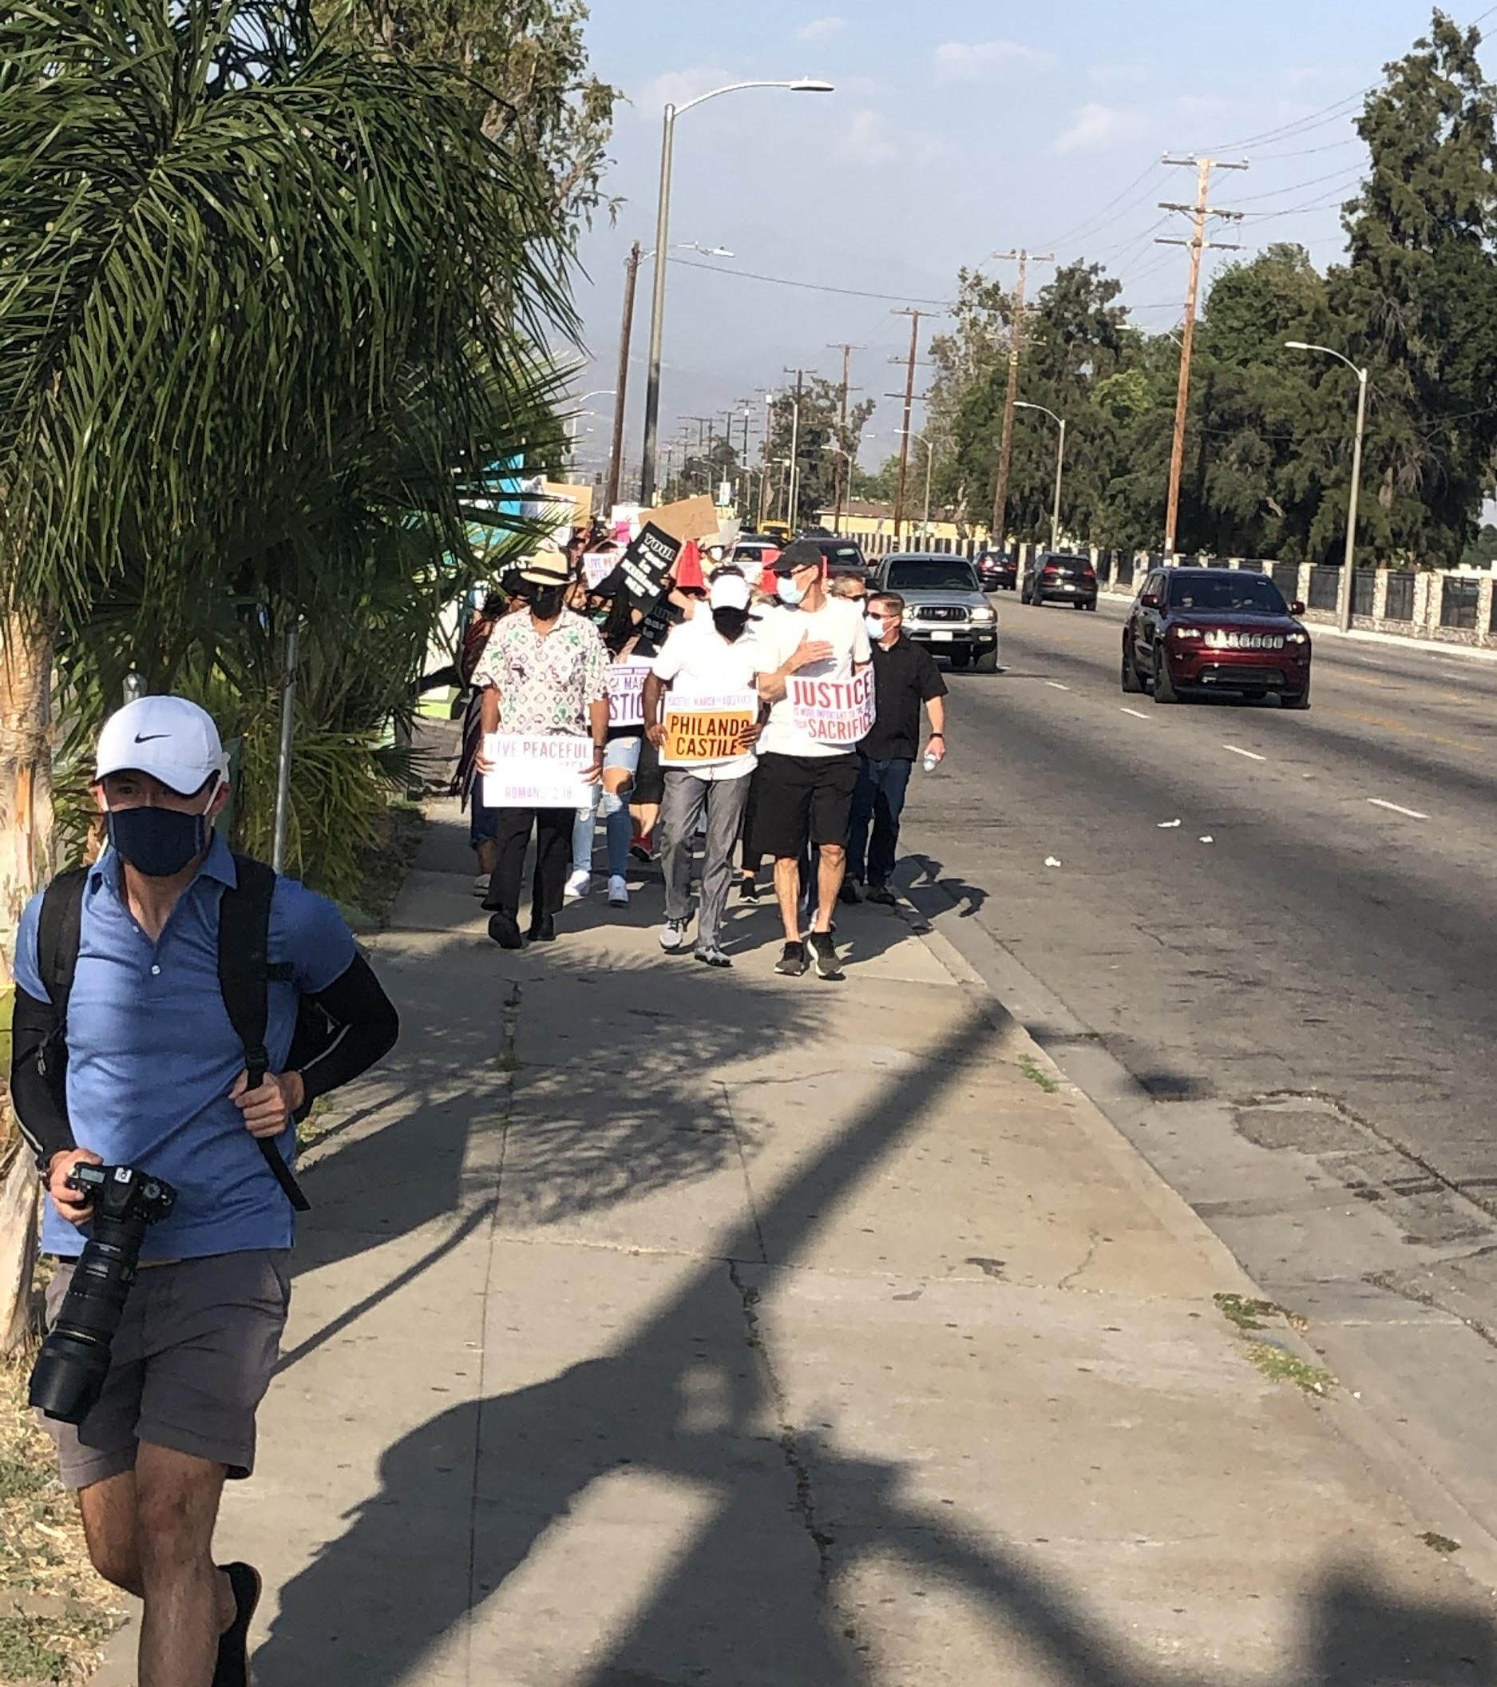
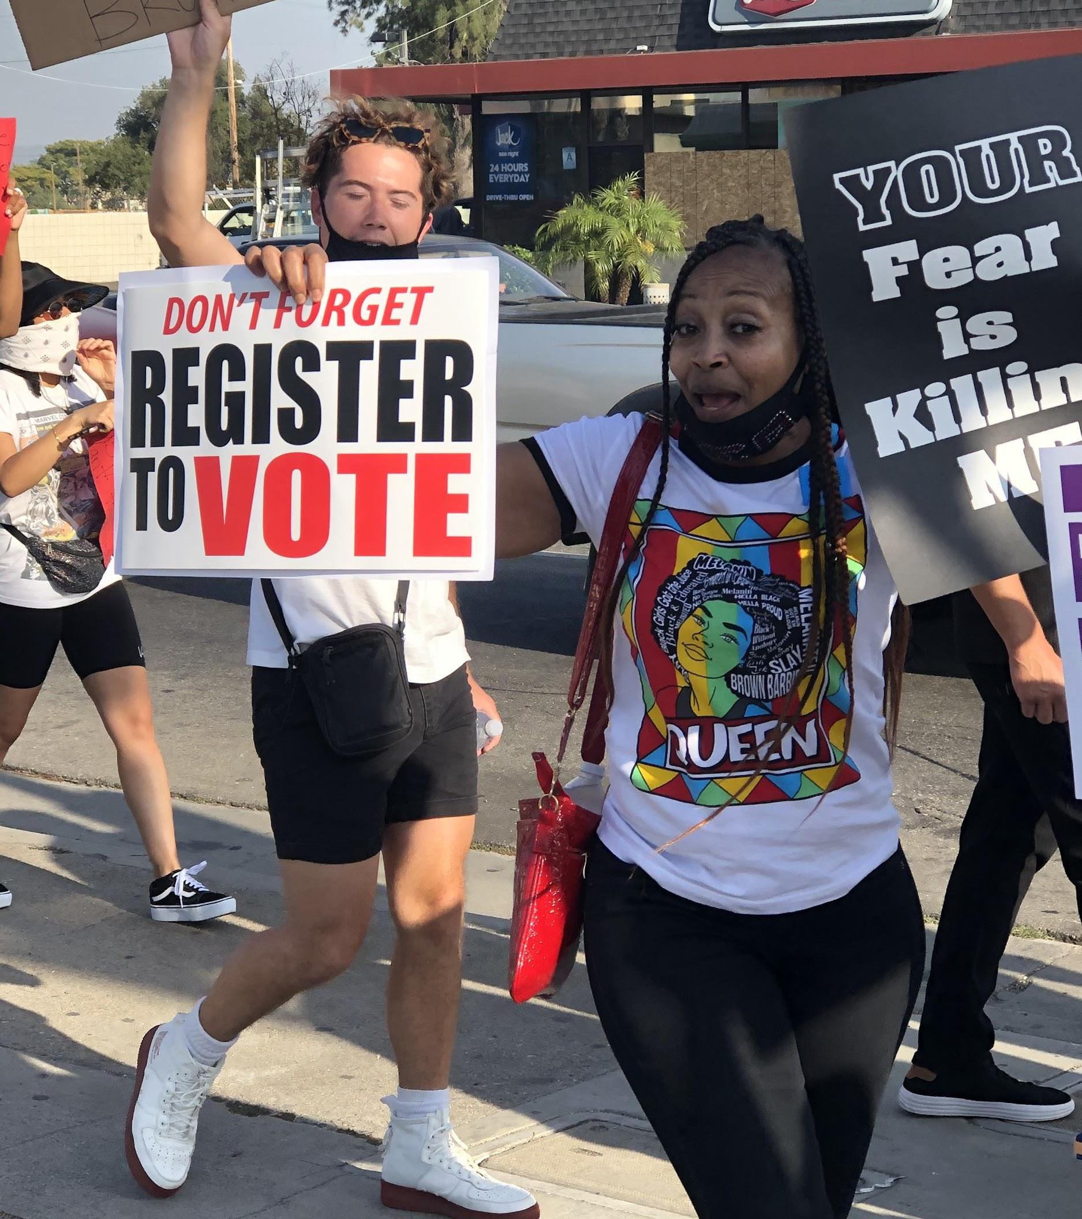
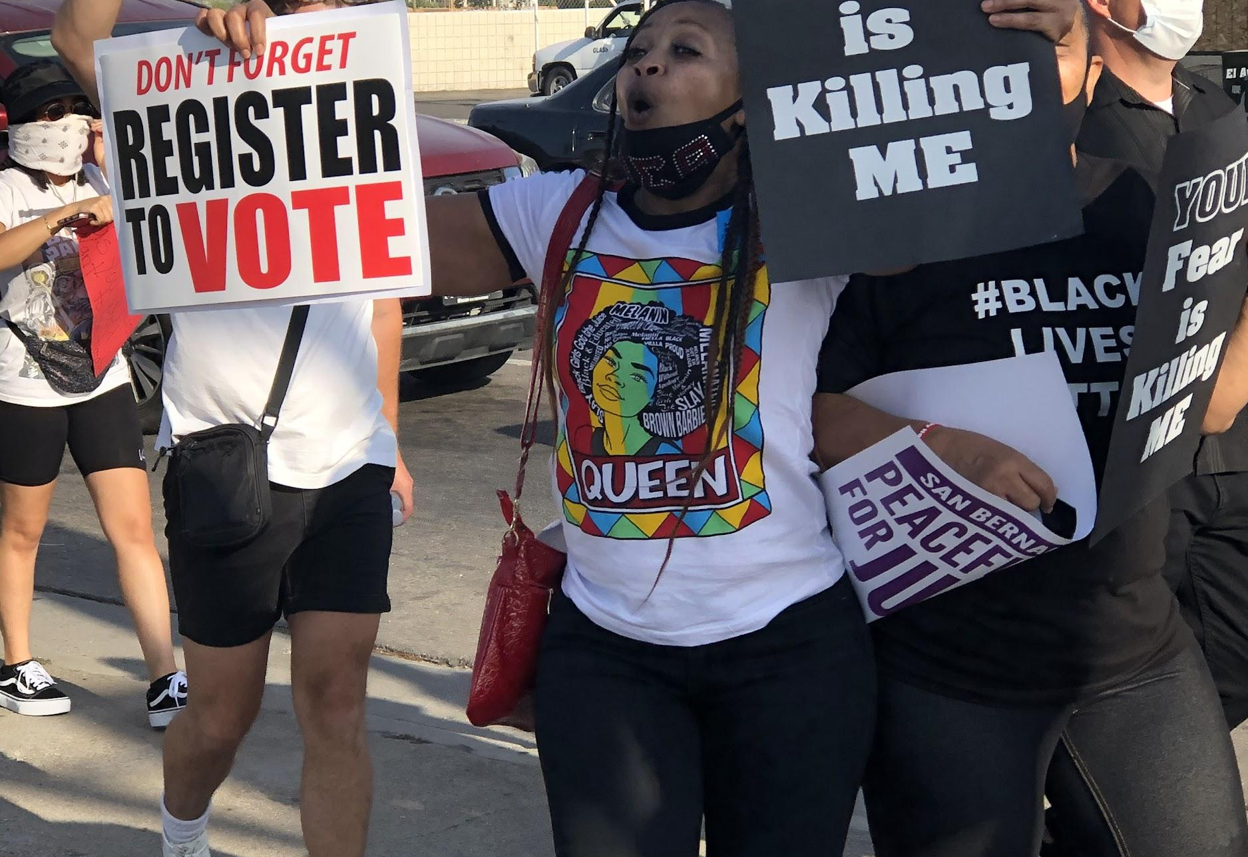
We marched to end police brutality!

Slide 7
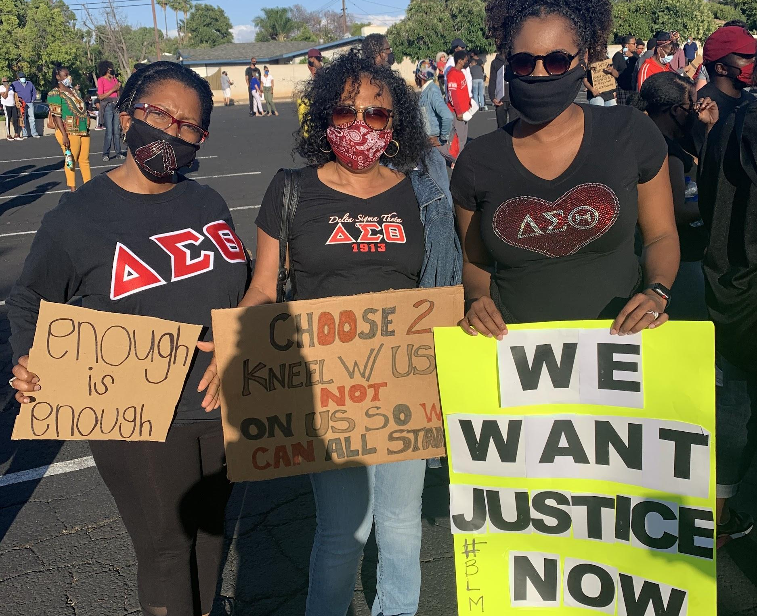
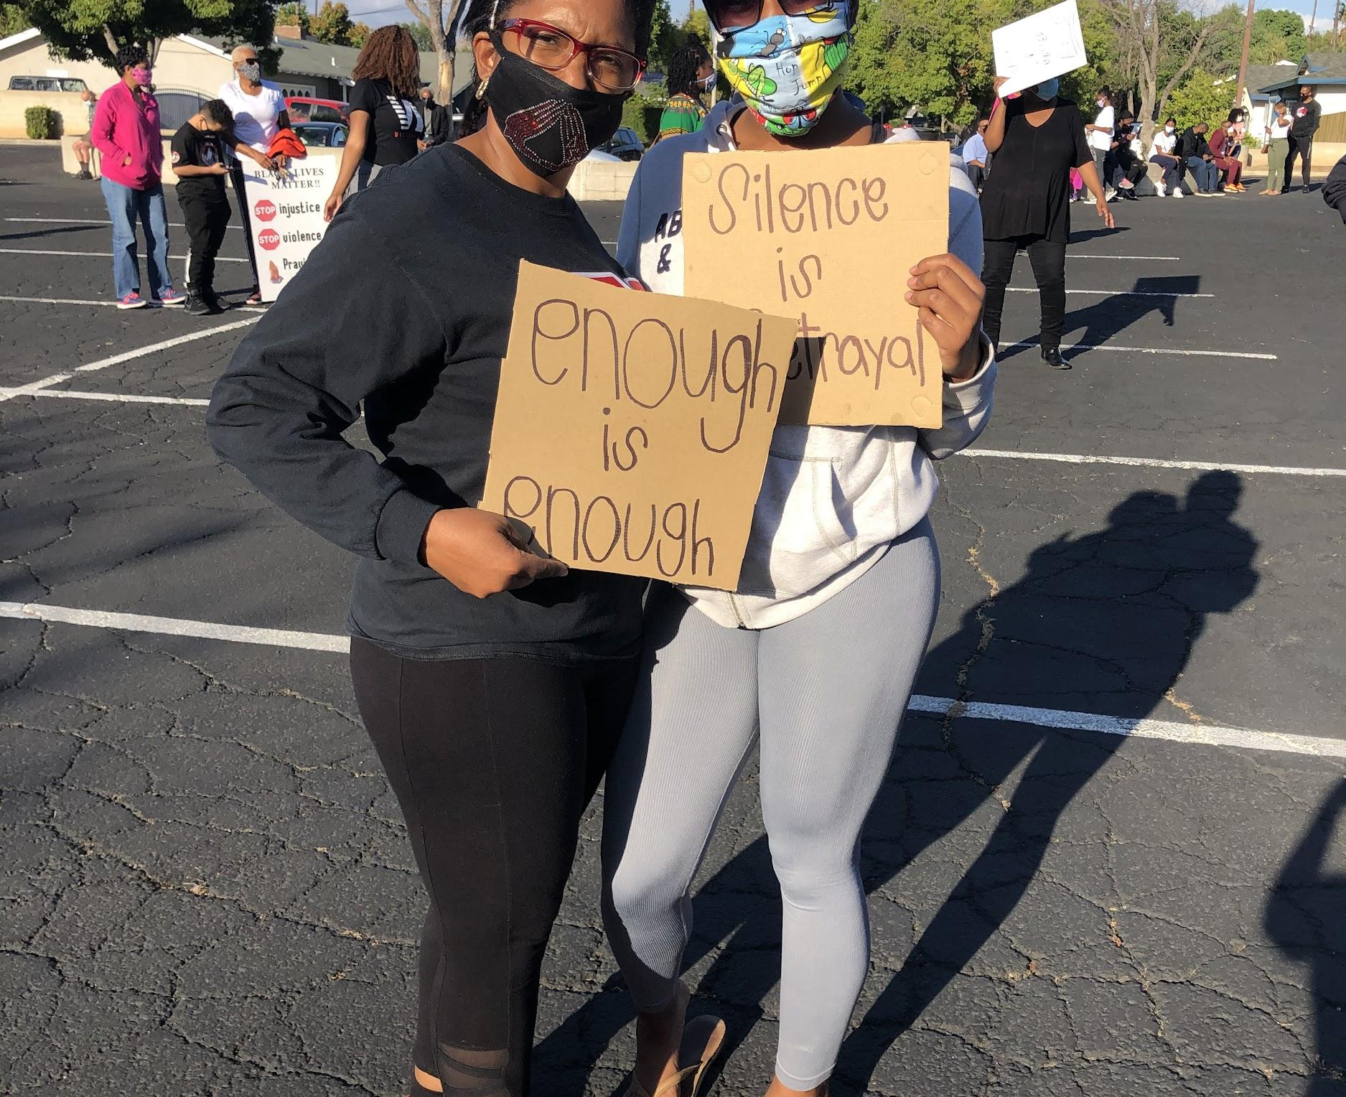
We participated in peaceful protests...

Slide 8
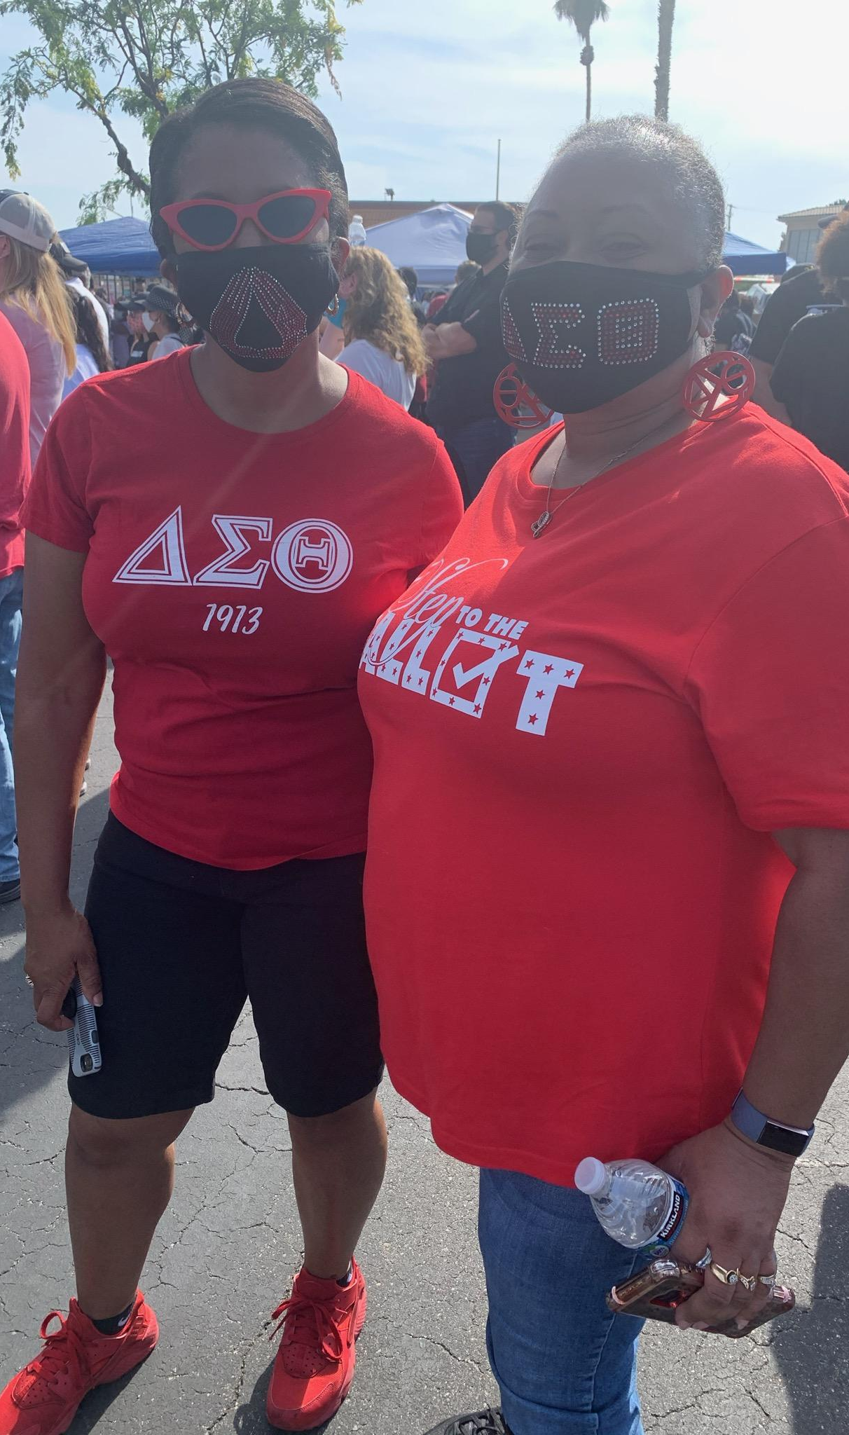
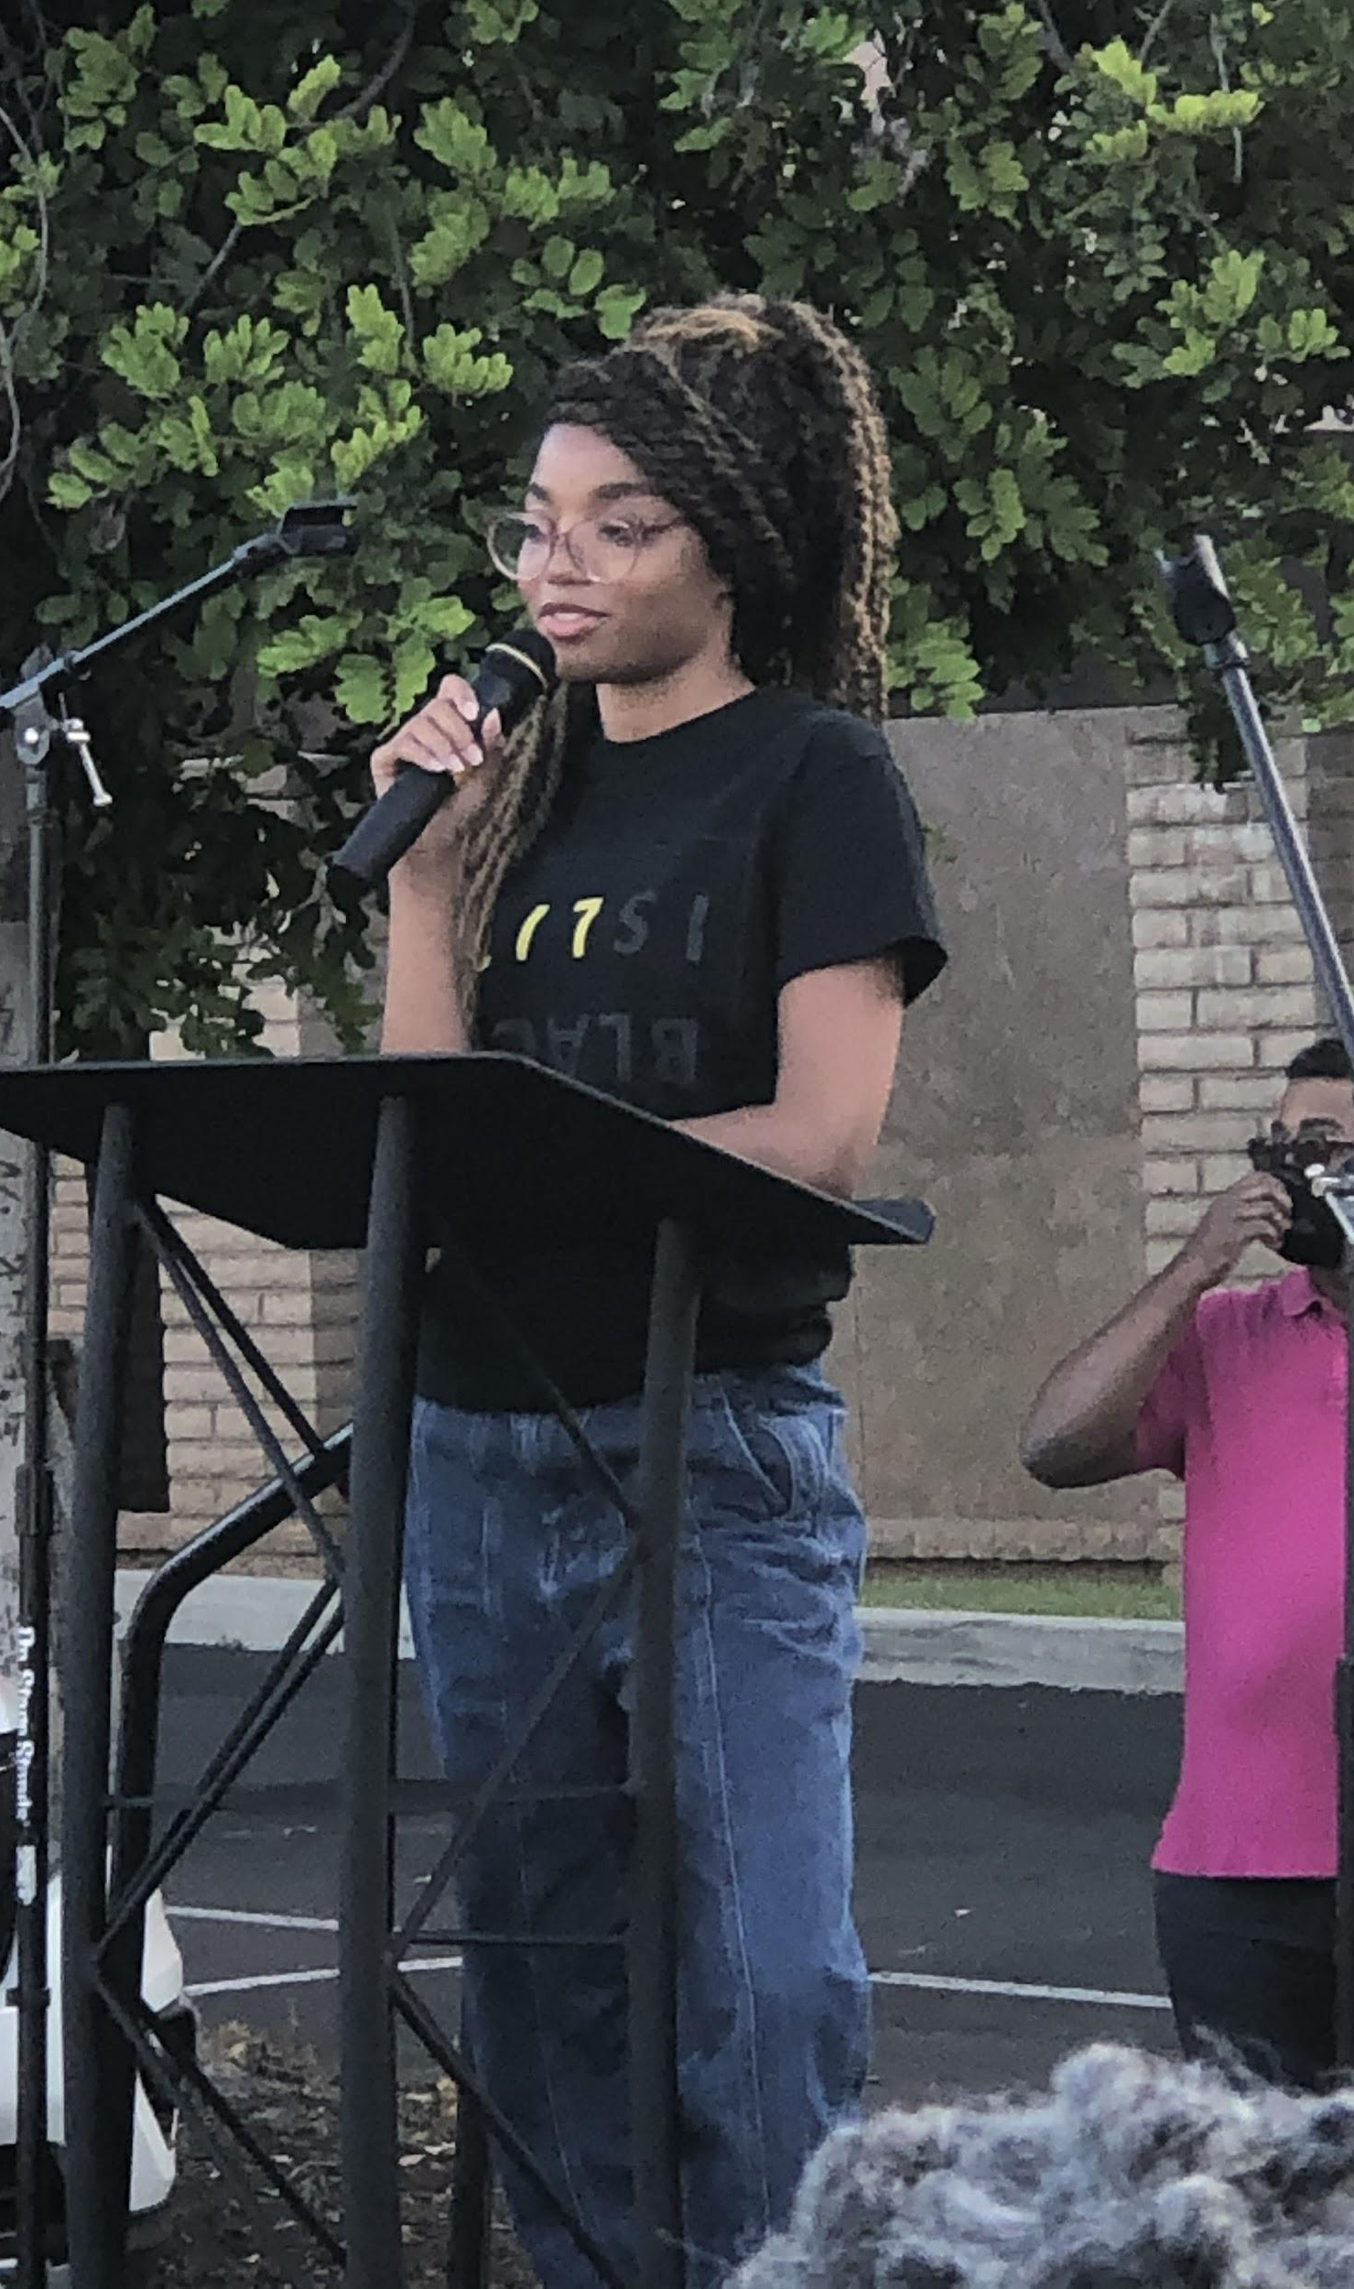

Slide 9
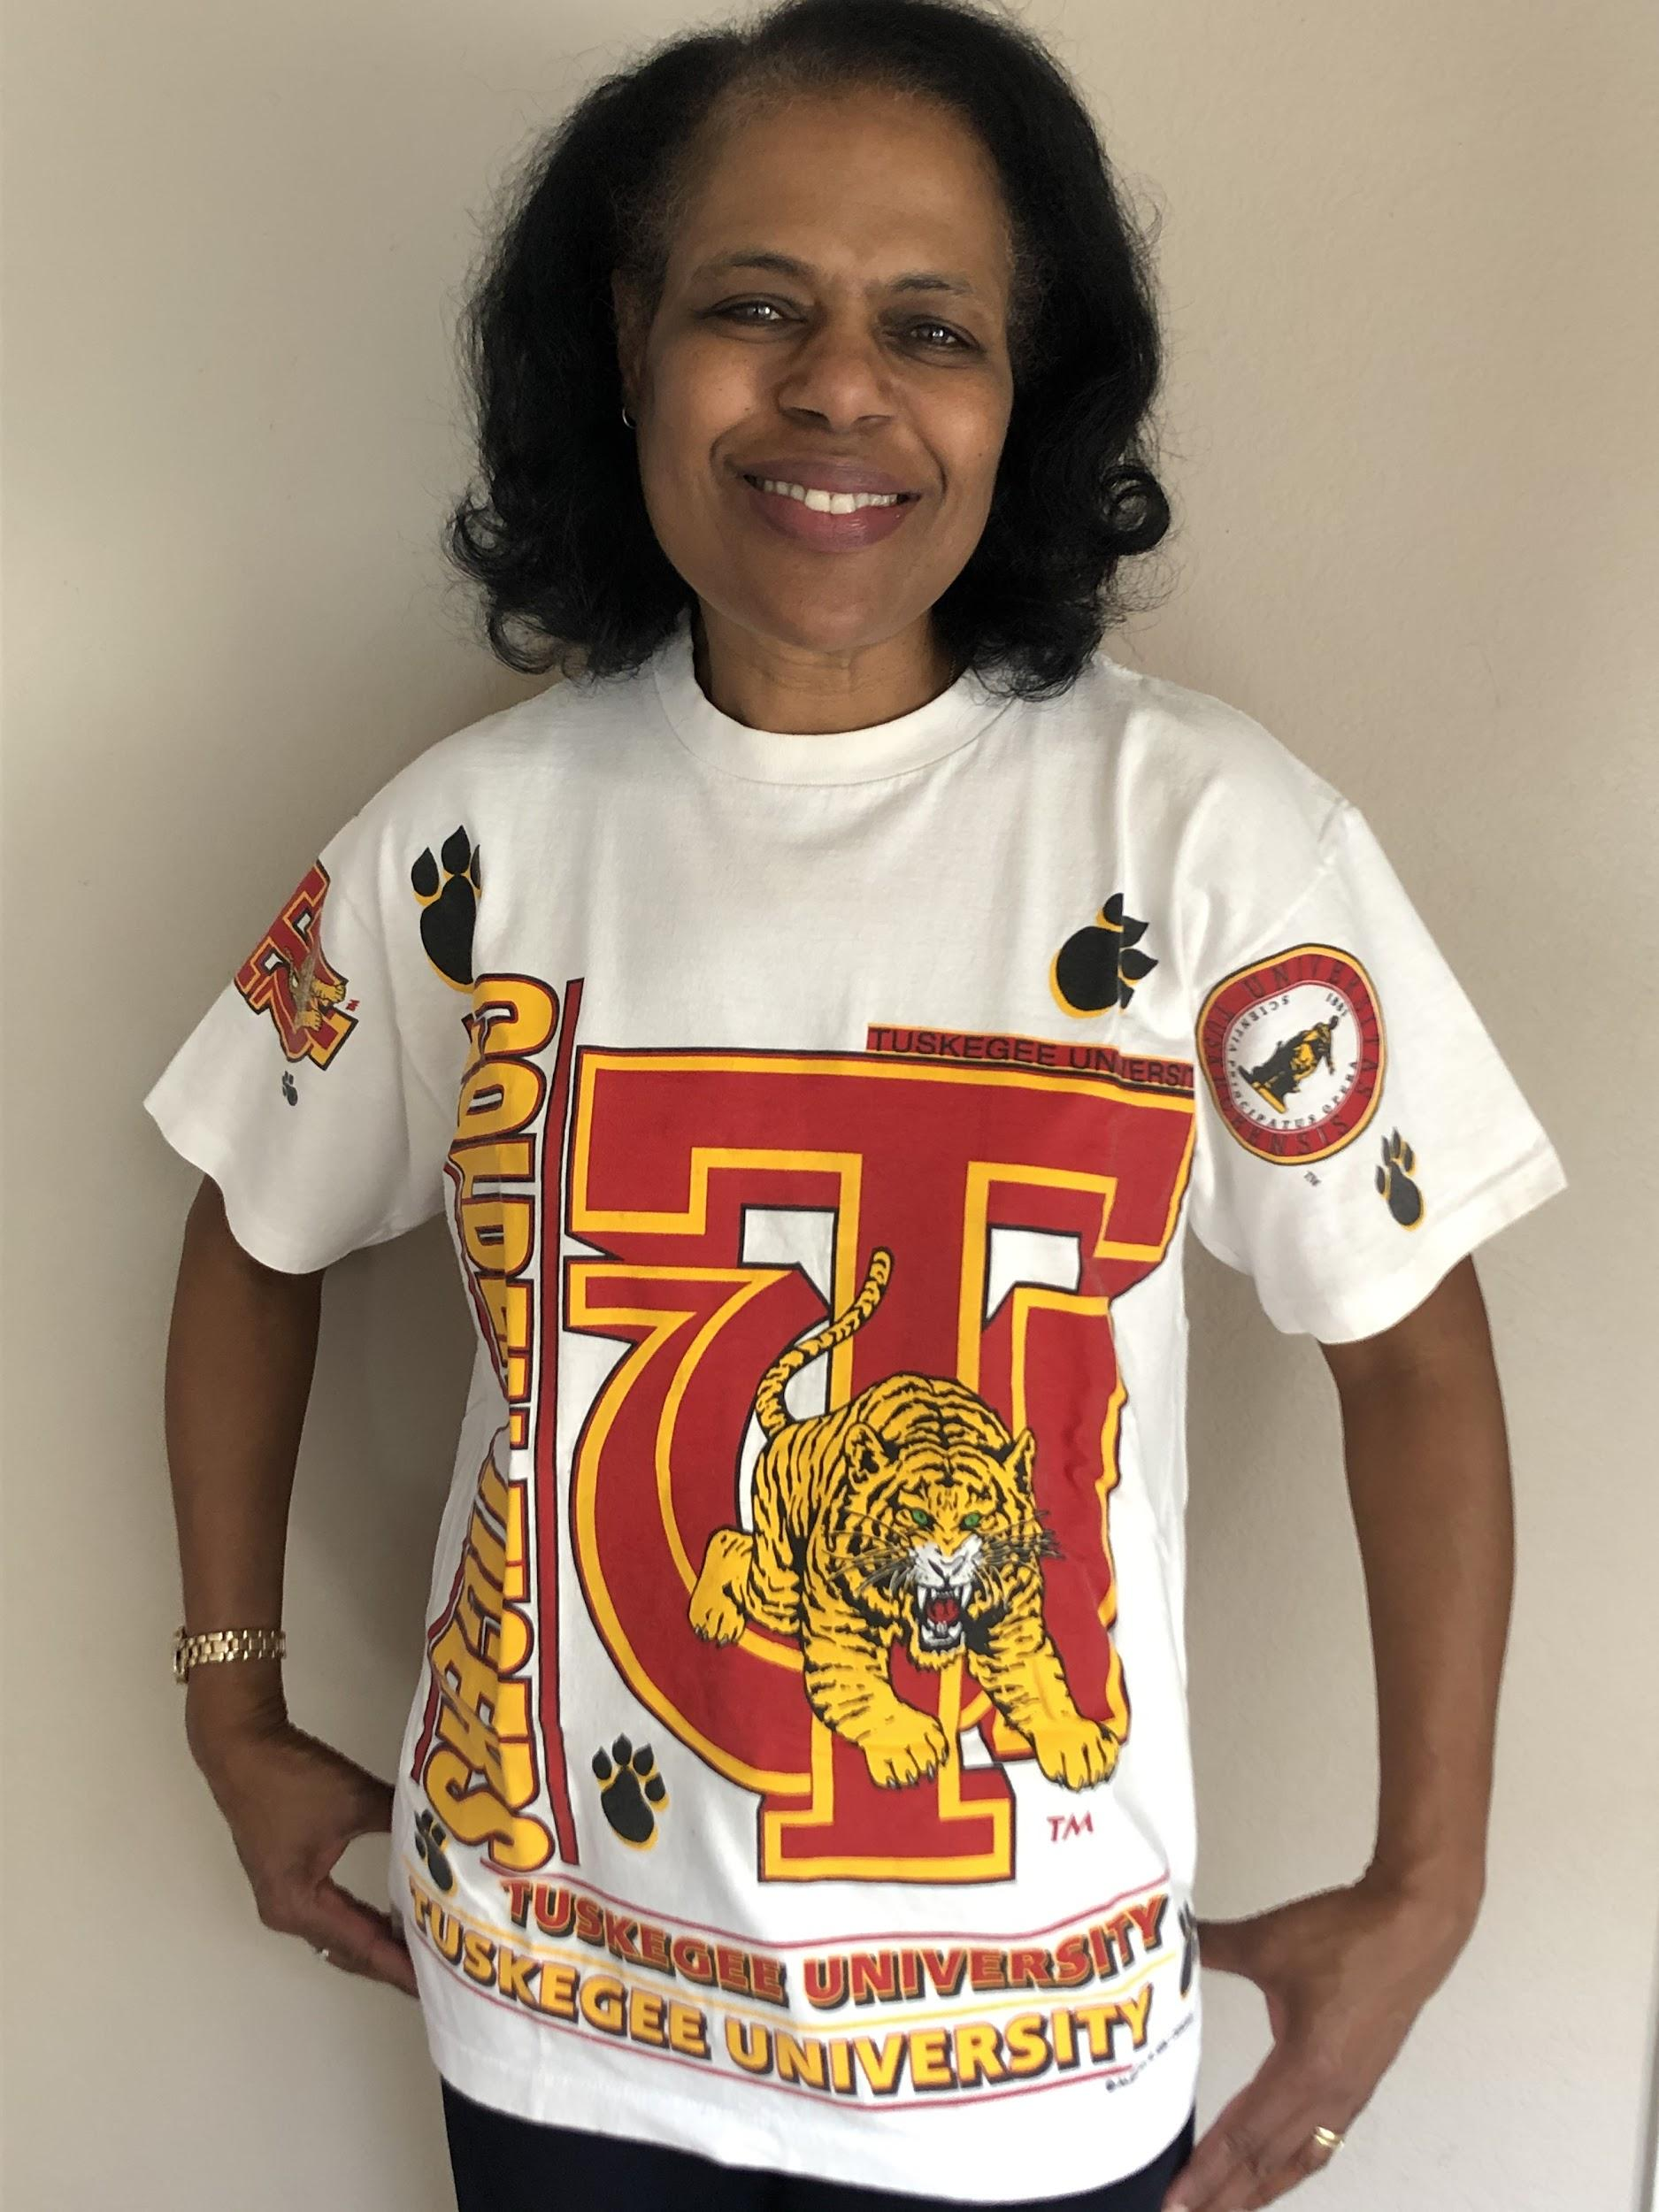
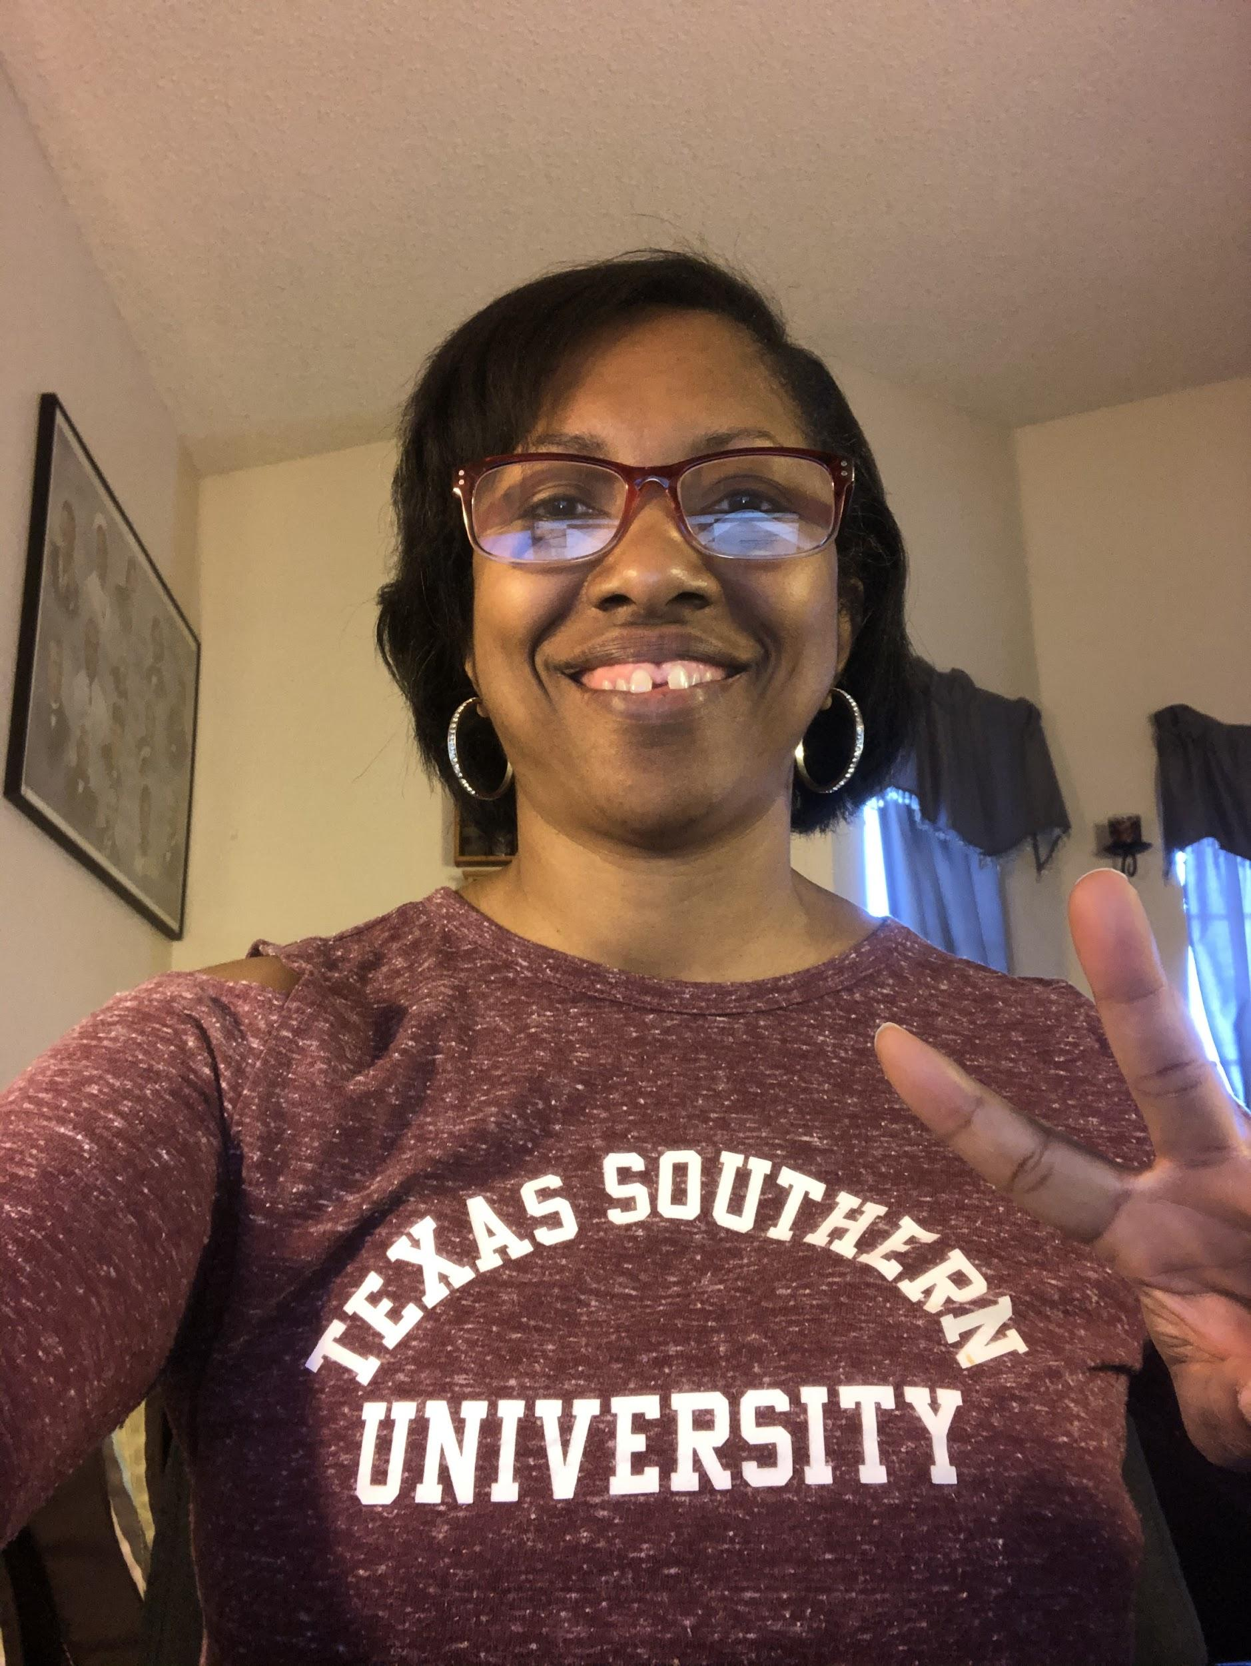
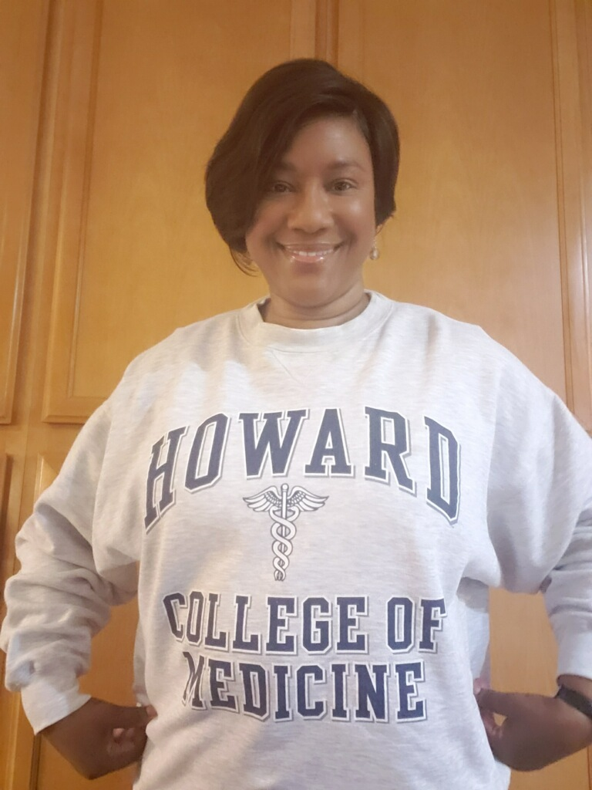
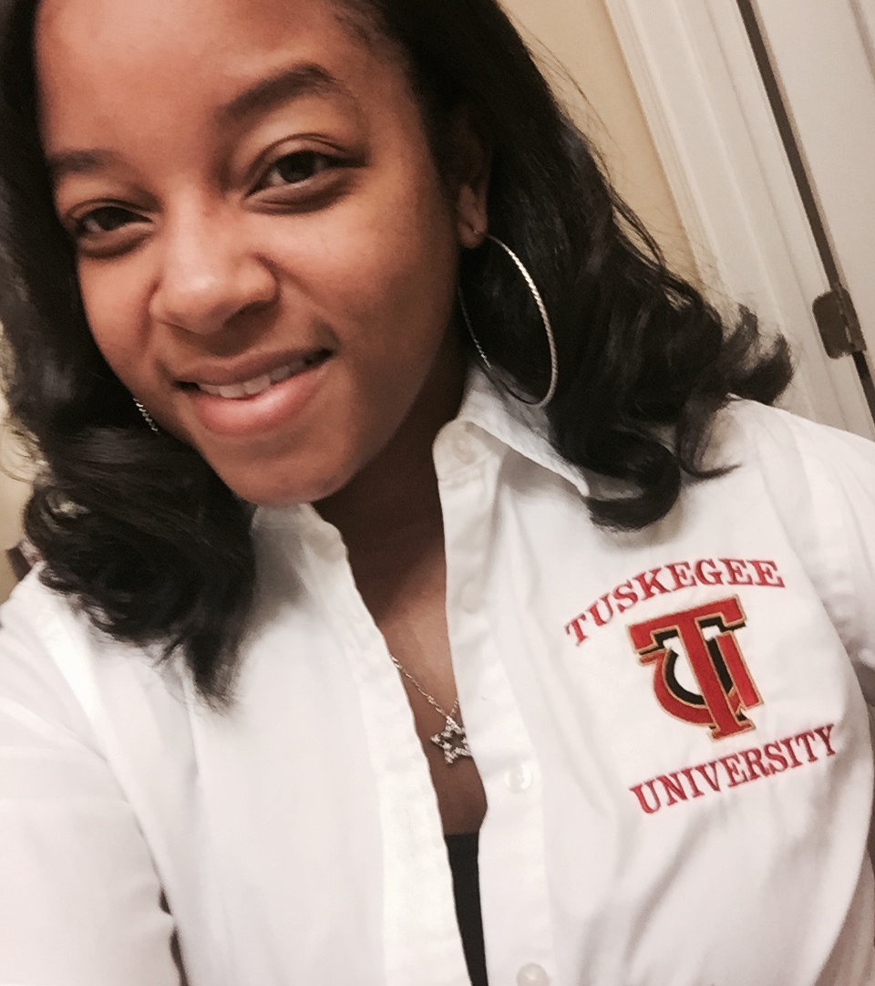
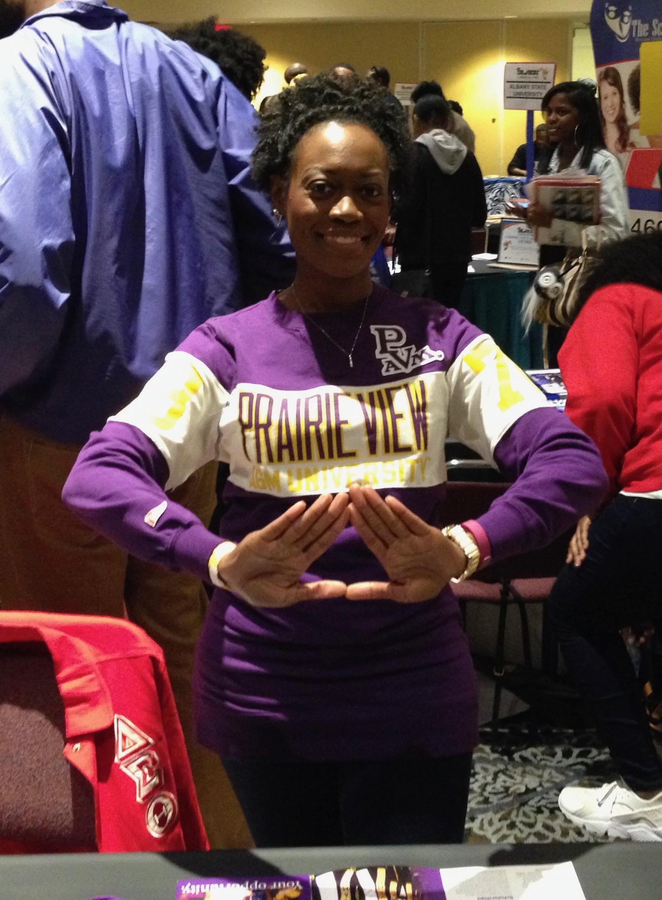
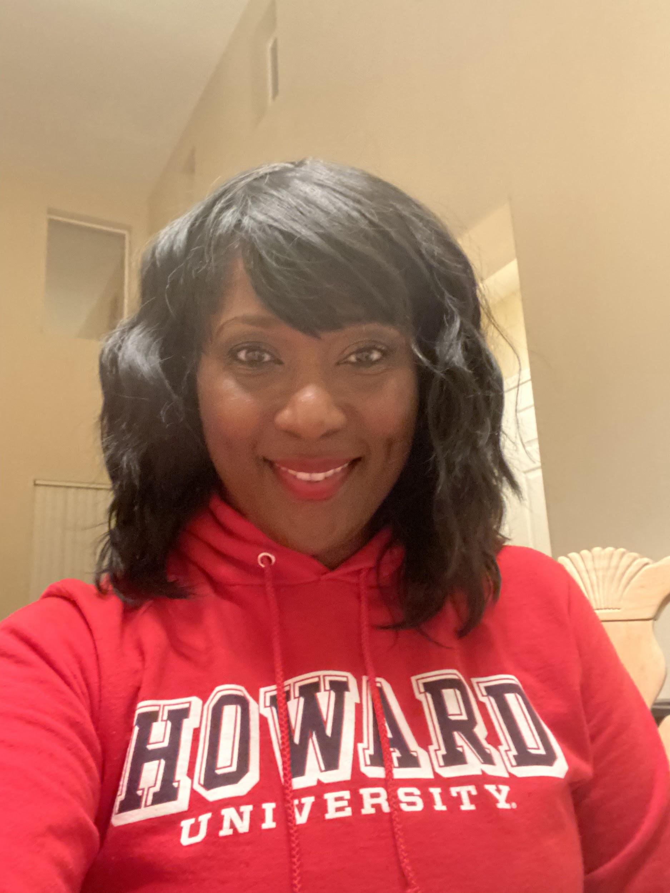
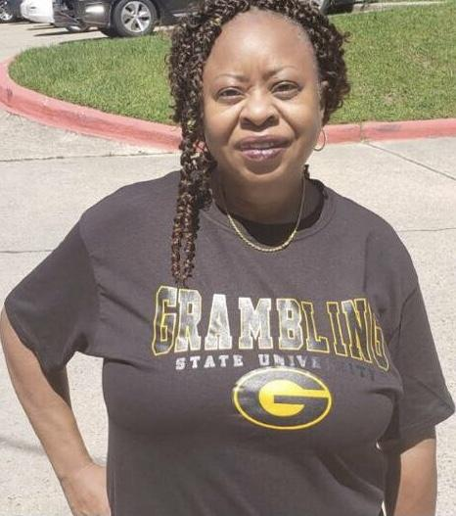
We advocated for funding for our HBCUs
Notes:
Howard University, Tuskegee University, Texas Southern University, Grambling State University and Prairie View A&M University are represented here.

Slide 10
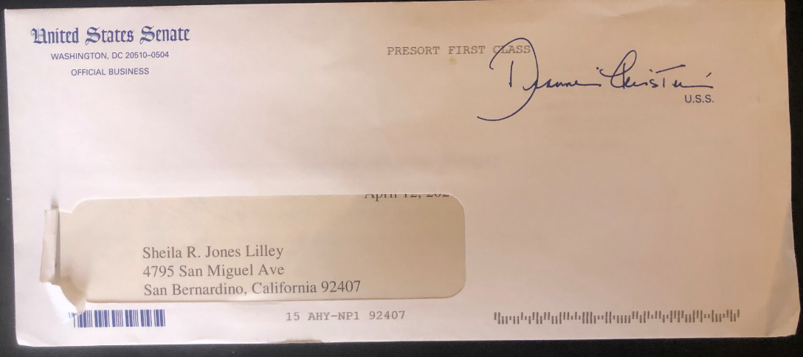
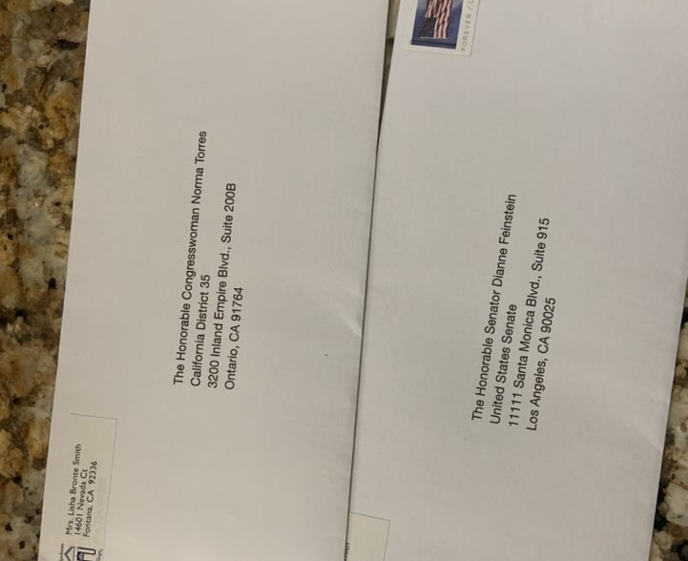
We wrote advocacy letters…...and more letters demanding the revocation of Trump Executive Order #13950! We are happy to say this Executive order was indeed reversed on January 20, 2021 by President Biden.
And Senator Feinstein wrote back!
Notes:
I am happy to say this Executive order was indeed reversed on January 20, 2020 by President Biden.

Slide 11
We sent nearly 100 letters to our local Police Chiefs demanding body worn cameras! We sent letters to law enforcement in every city in our service area including San Bernardino, Riverside, Redlands, Rialto,
Fontana, Eastvale, Corona and Lake Elsinore.

Slide 12
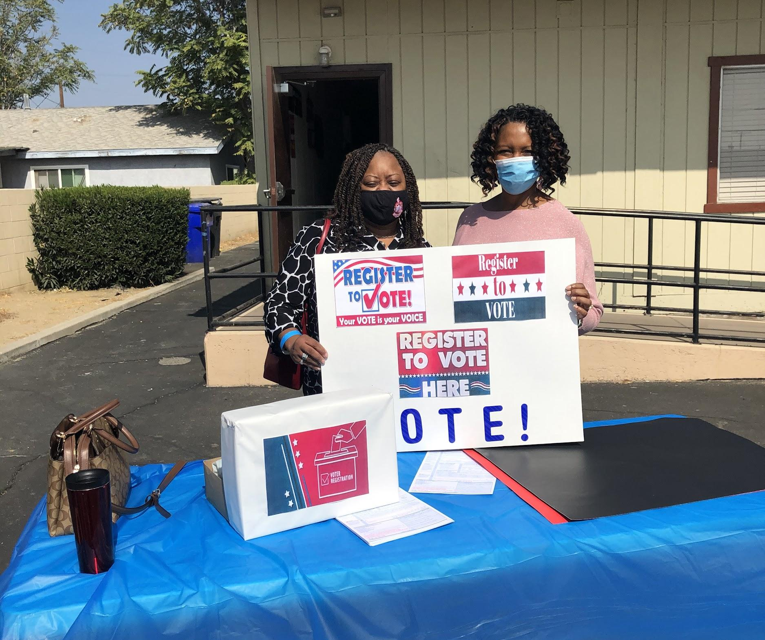
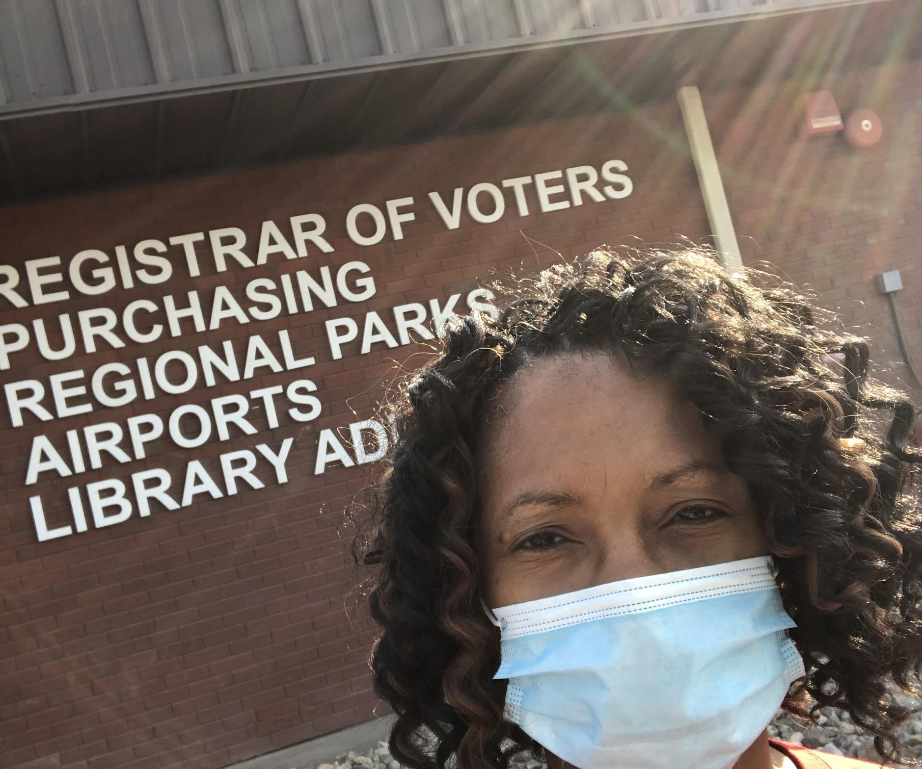
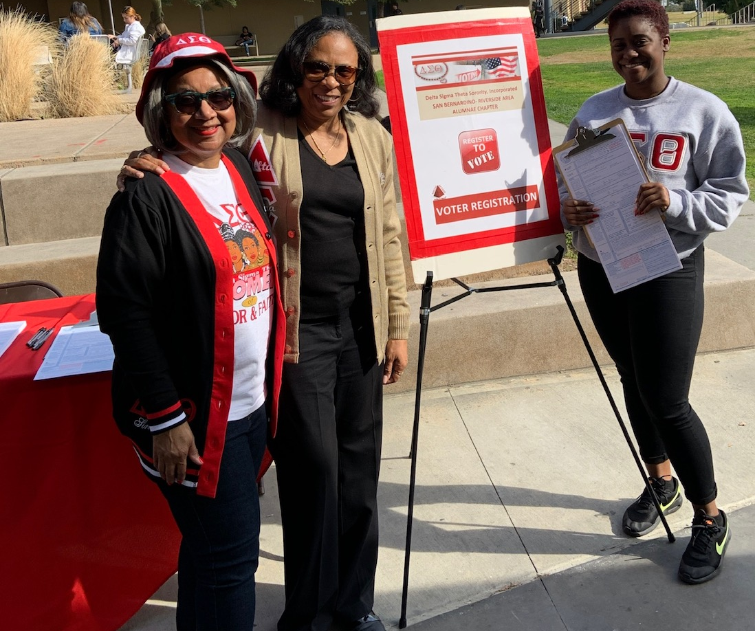
We registered people to VOTE
Notes:
Both before Covid and during Covid we registered people to vote at our churches and Community Colleges.

Slide 13
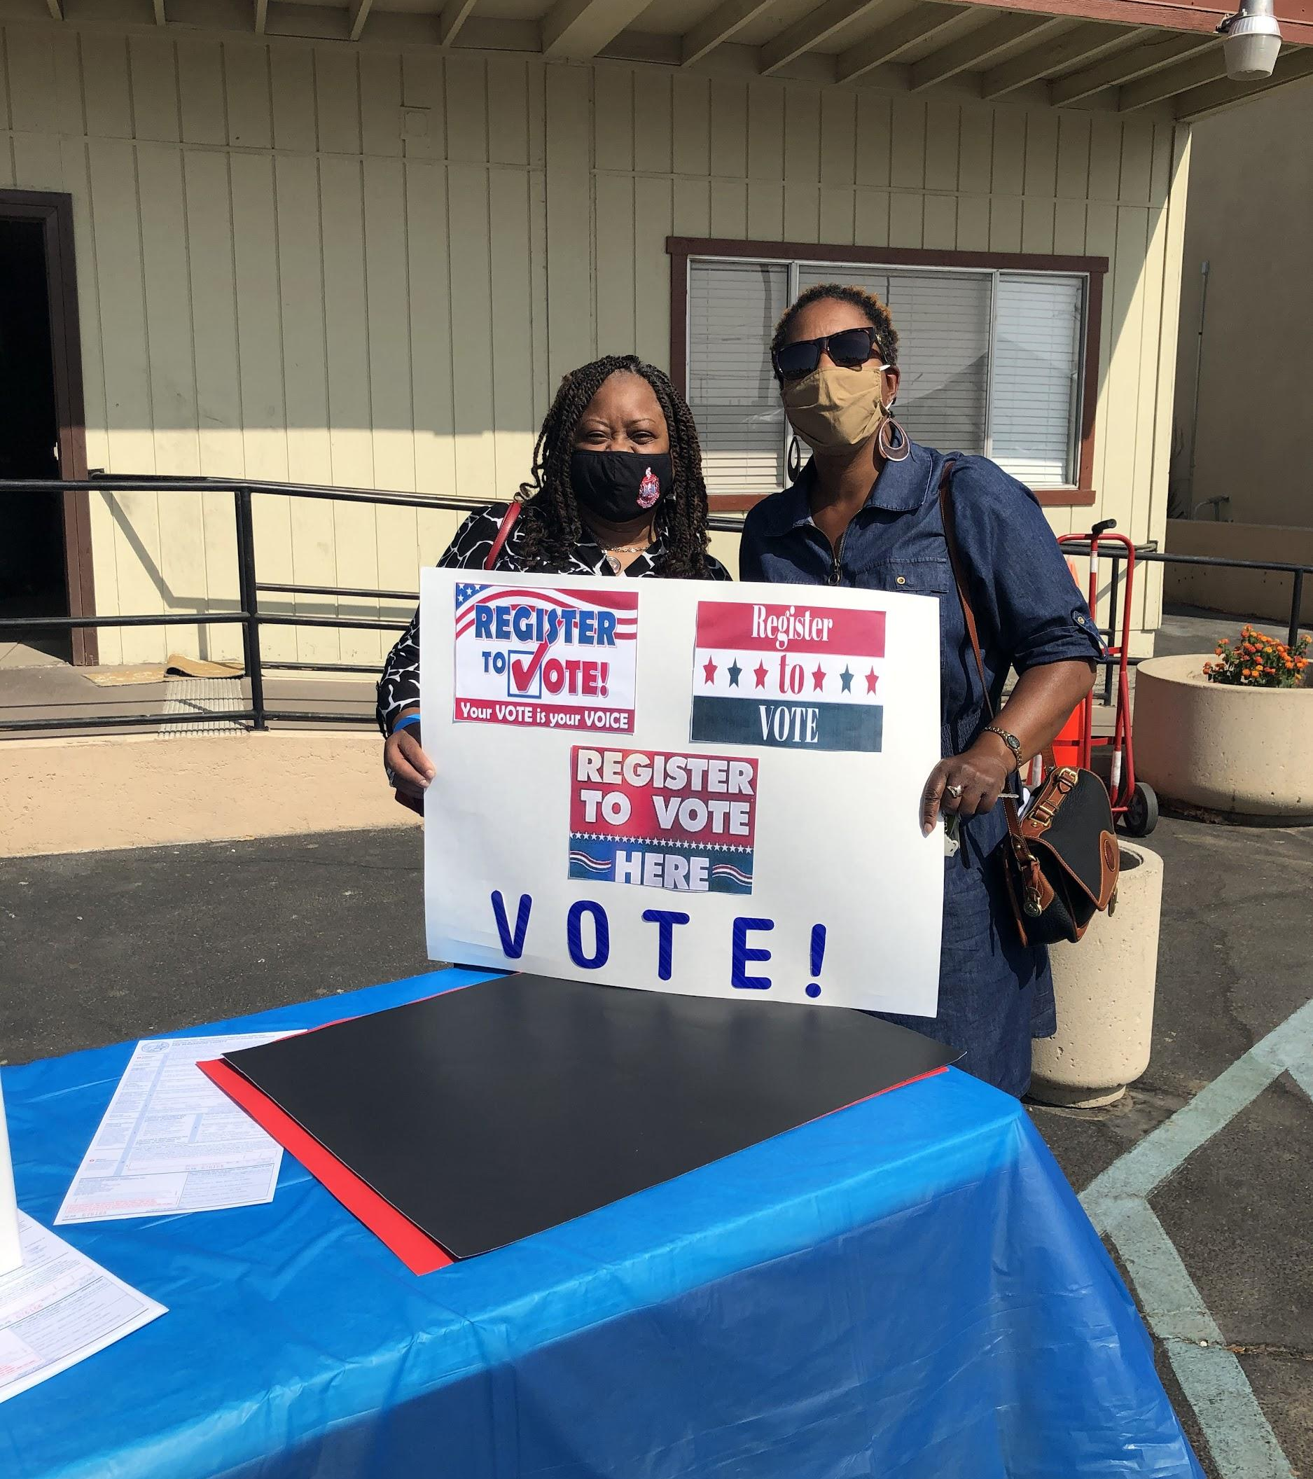
Several Sorors even worked the polls and
became poll watchers!
Notes:
Some Sorors

Slide 14
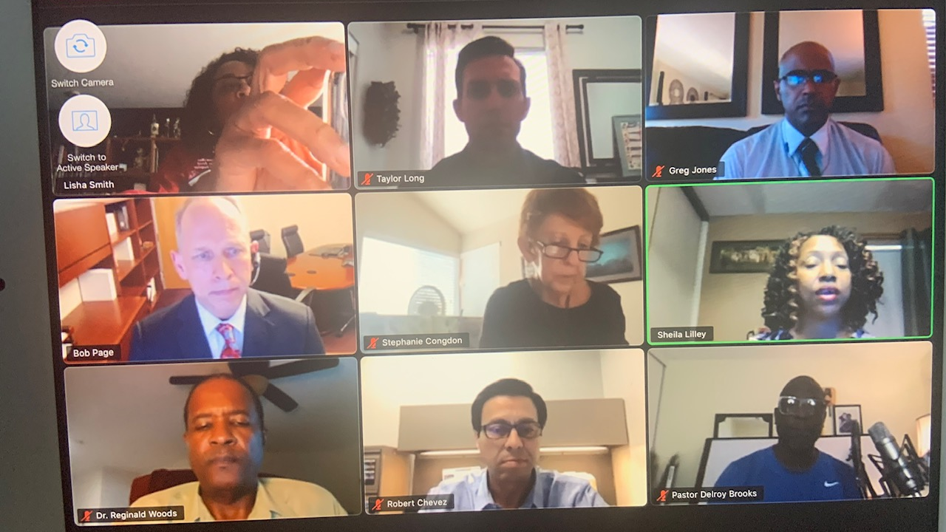
We co-hosted a Voter Registration and Education Panel with the Registrar of Voters!
Malibu sunset

Slide 15
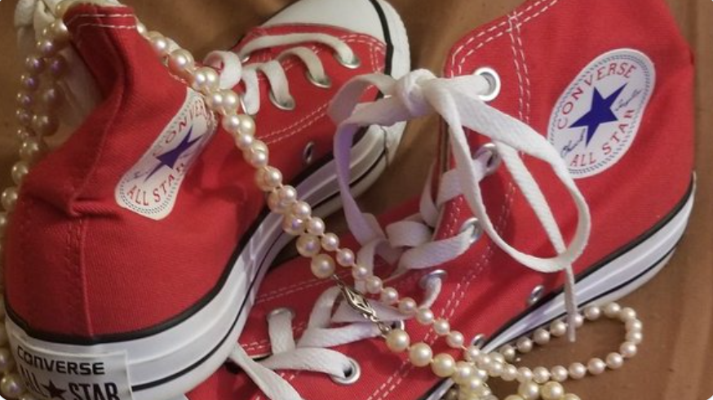
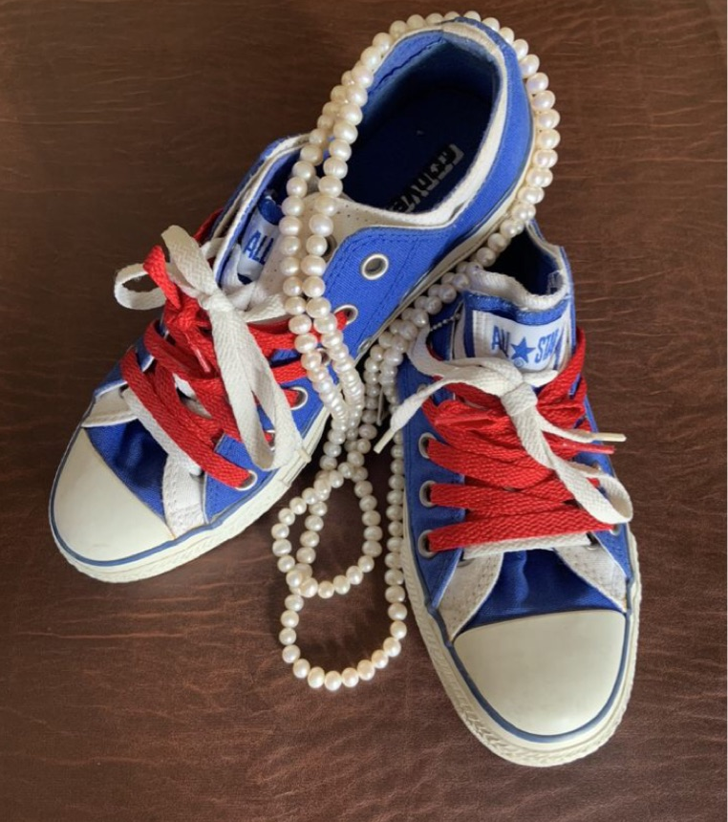
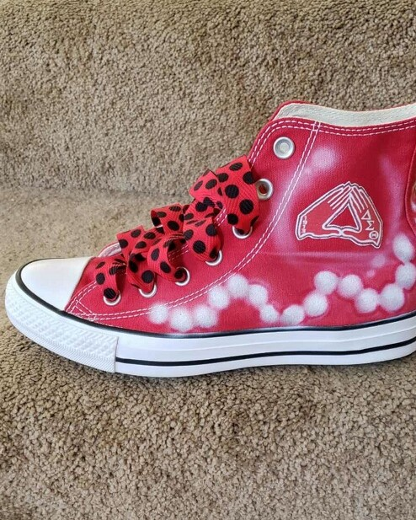
We wore our Chucks in solidarity with our Panhellenic sister and current Vice President Kamala Harris!

Slide 16
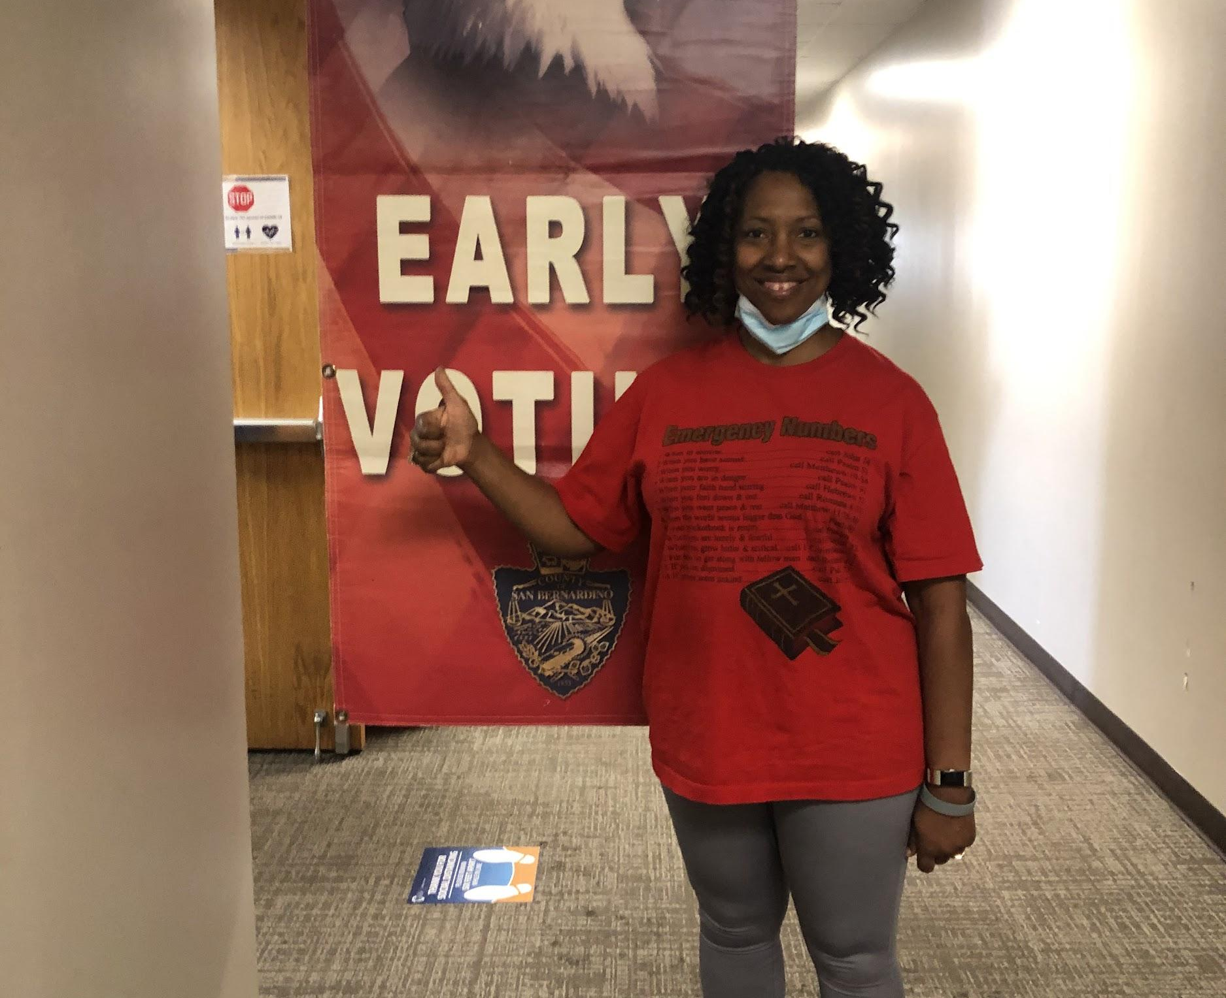
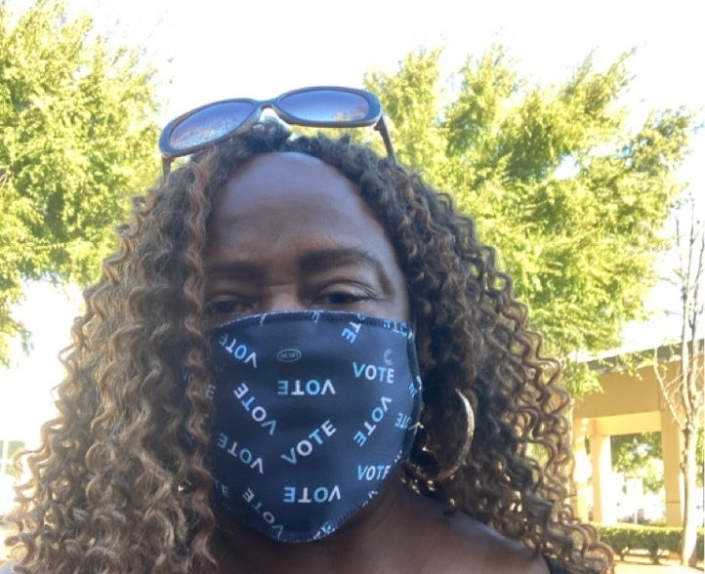
AND WE VOTED AND VOTED AND VOTED!!!

Slide 17
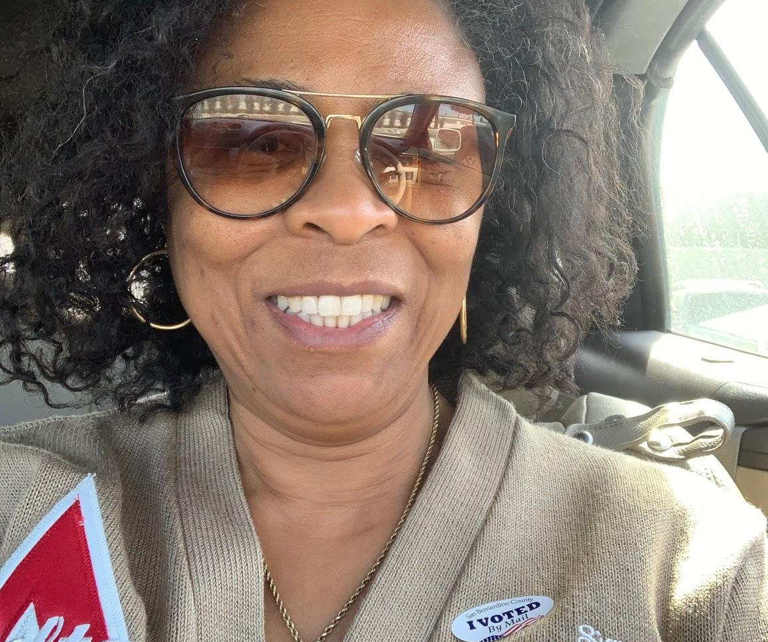
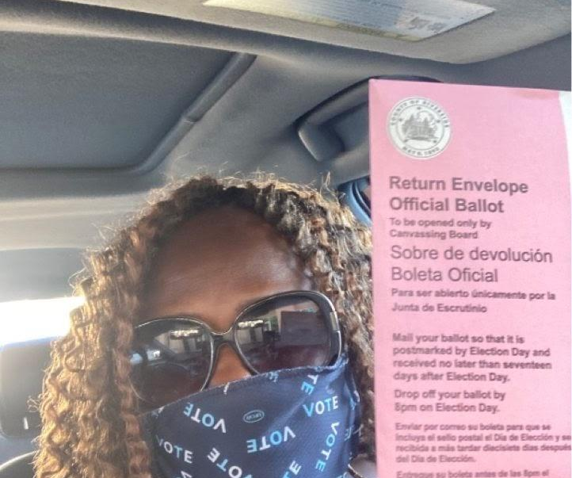
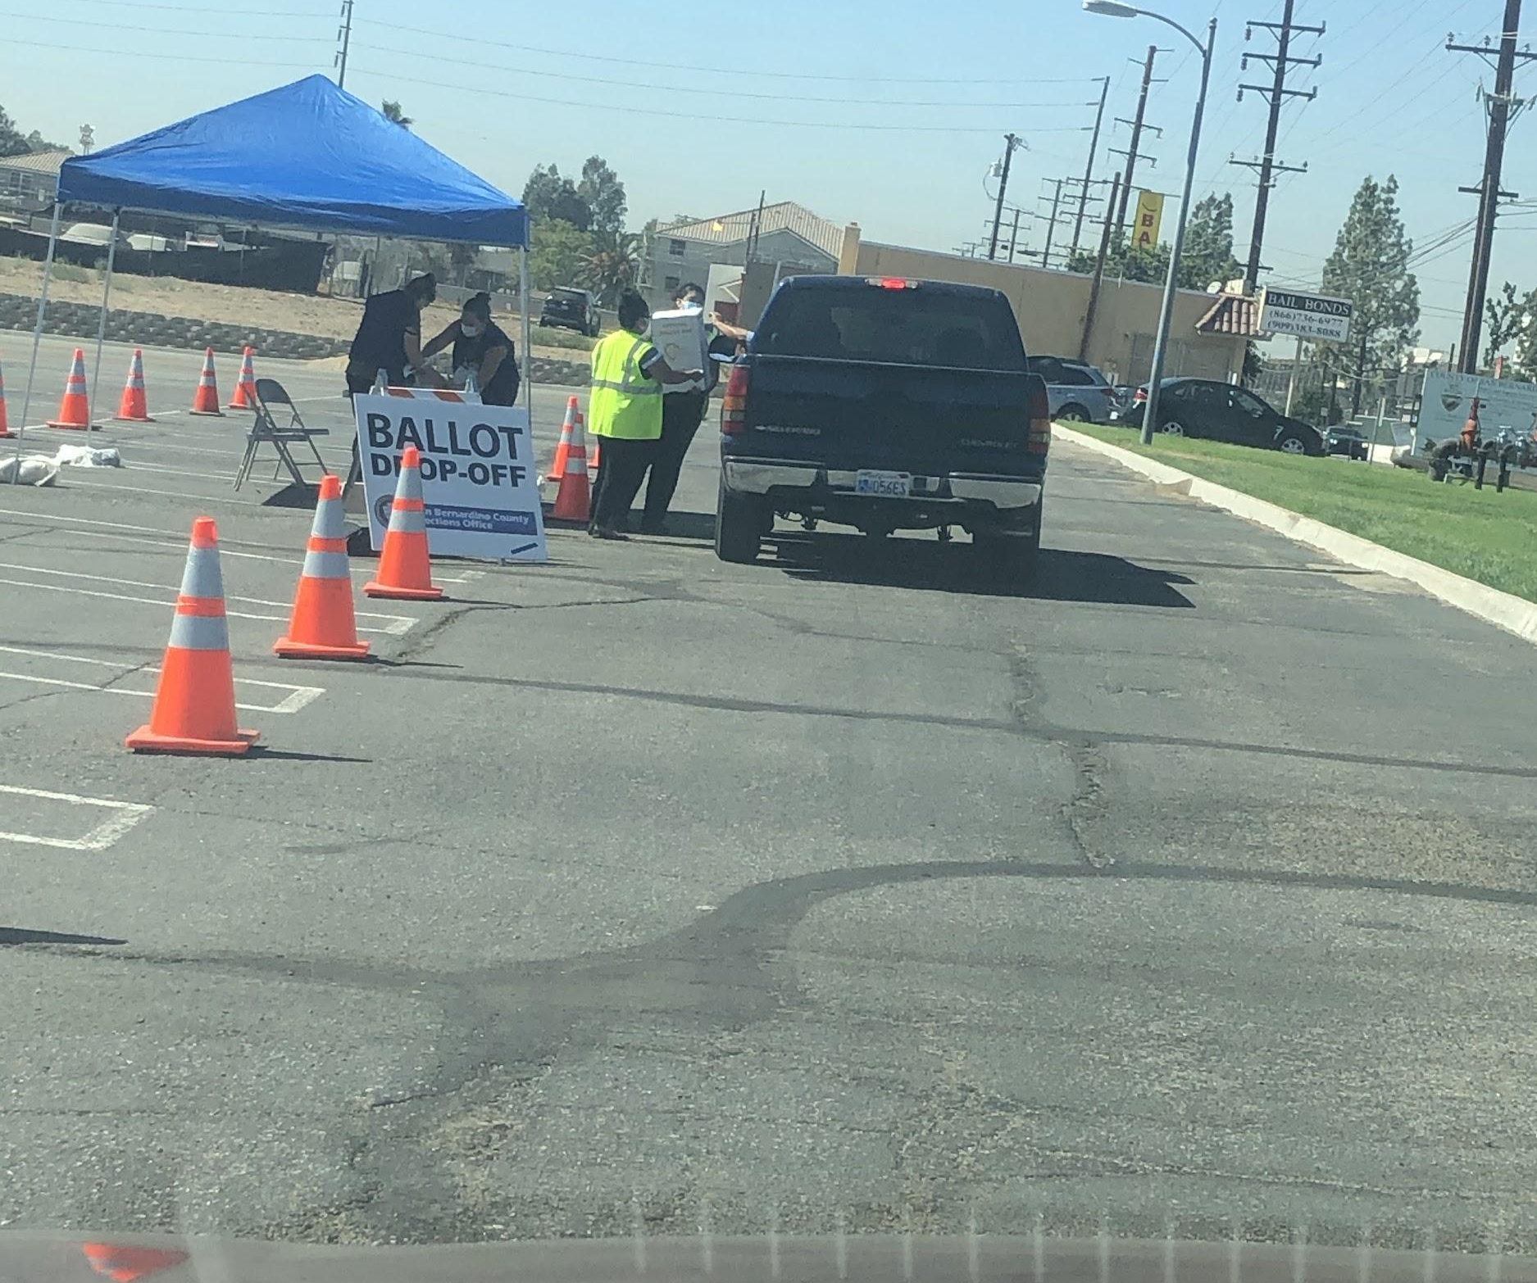

Slide 18
WE RAN FOR OFFICE
AND……….. WE WON!!!
Soror Hawkins received the highest number of votes of all candidates and became the Democratic Party Delegate
for the 47th district.

Slide 19
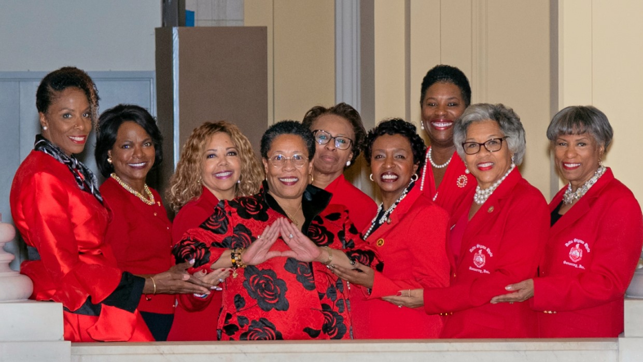
We ran for Congress and we won that too!!!
Malibu sunset
Notes:
Soror Karen Bass of California’s 37th District went on to Sponsor the George Floyd Justice in Policing Act

Slide 20
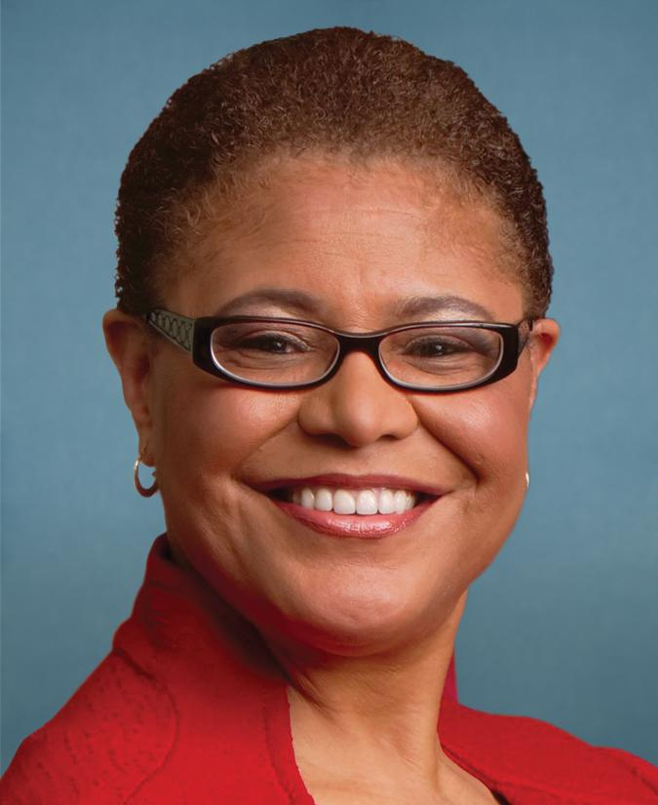
Soror Karen Bass, U.S. Representative for California’s 37th District, went on to sponsor the George Floyd Justice in Policing Act which among other things increases accountability for law enforcement misconduct, restricts the use of certain policing practices, enhances transparency and data collection and sharing of police misconduct, and establishes best practices and national standards for training requirements.
Notes:
It was passed by the House of Representatives and is pending in the Senate. President Biden has promised to sign immediately after it lands on his desk.

Slide 21
Past National President, Soror Marcia Fudge was appointed to be the Secretary of Housing and Urban Development
Notes:
Member of President Biden’s cabinet.

Slide 22
We lost a legend and an icon!

Slide 23
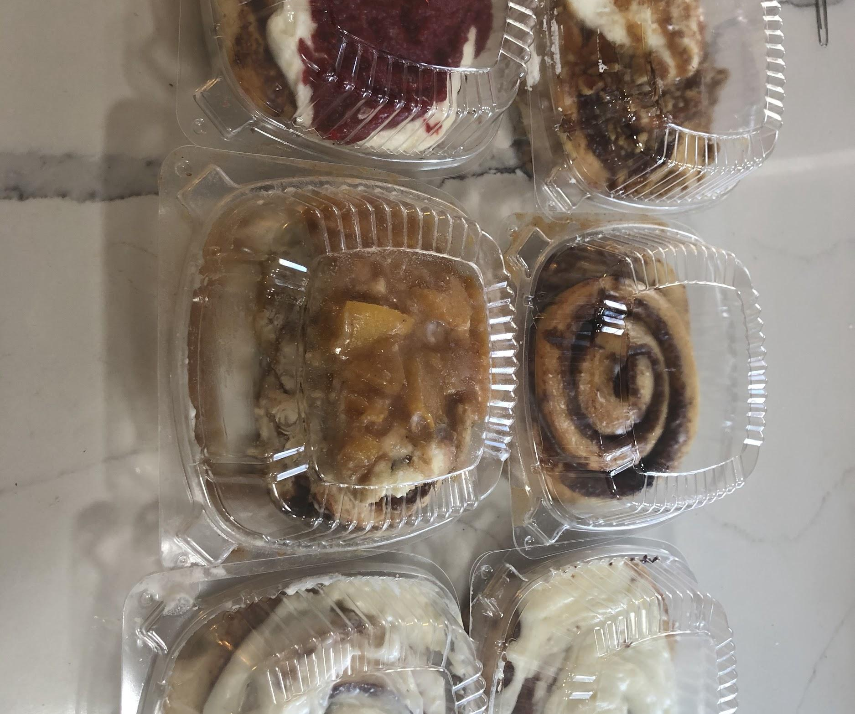
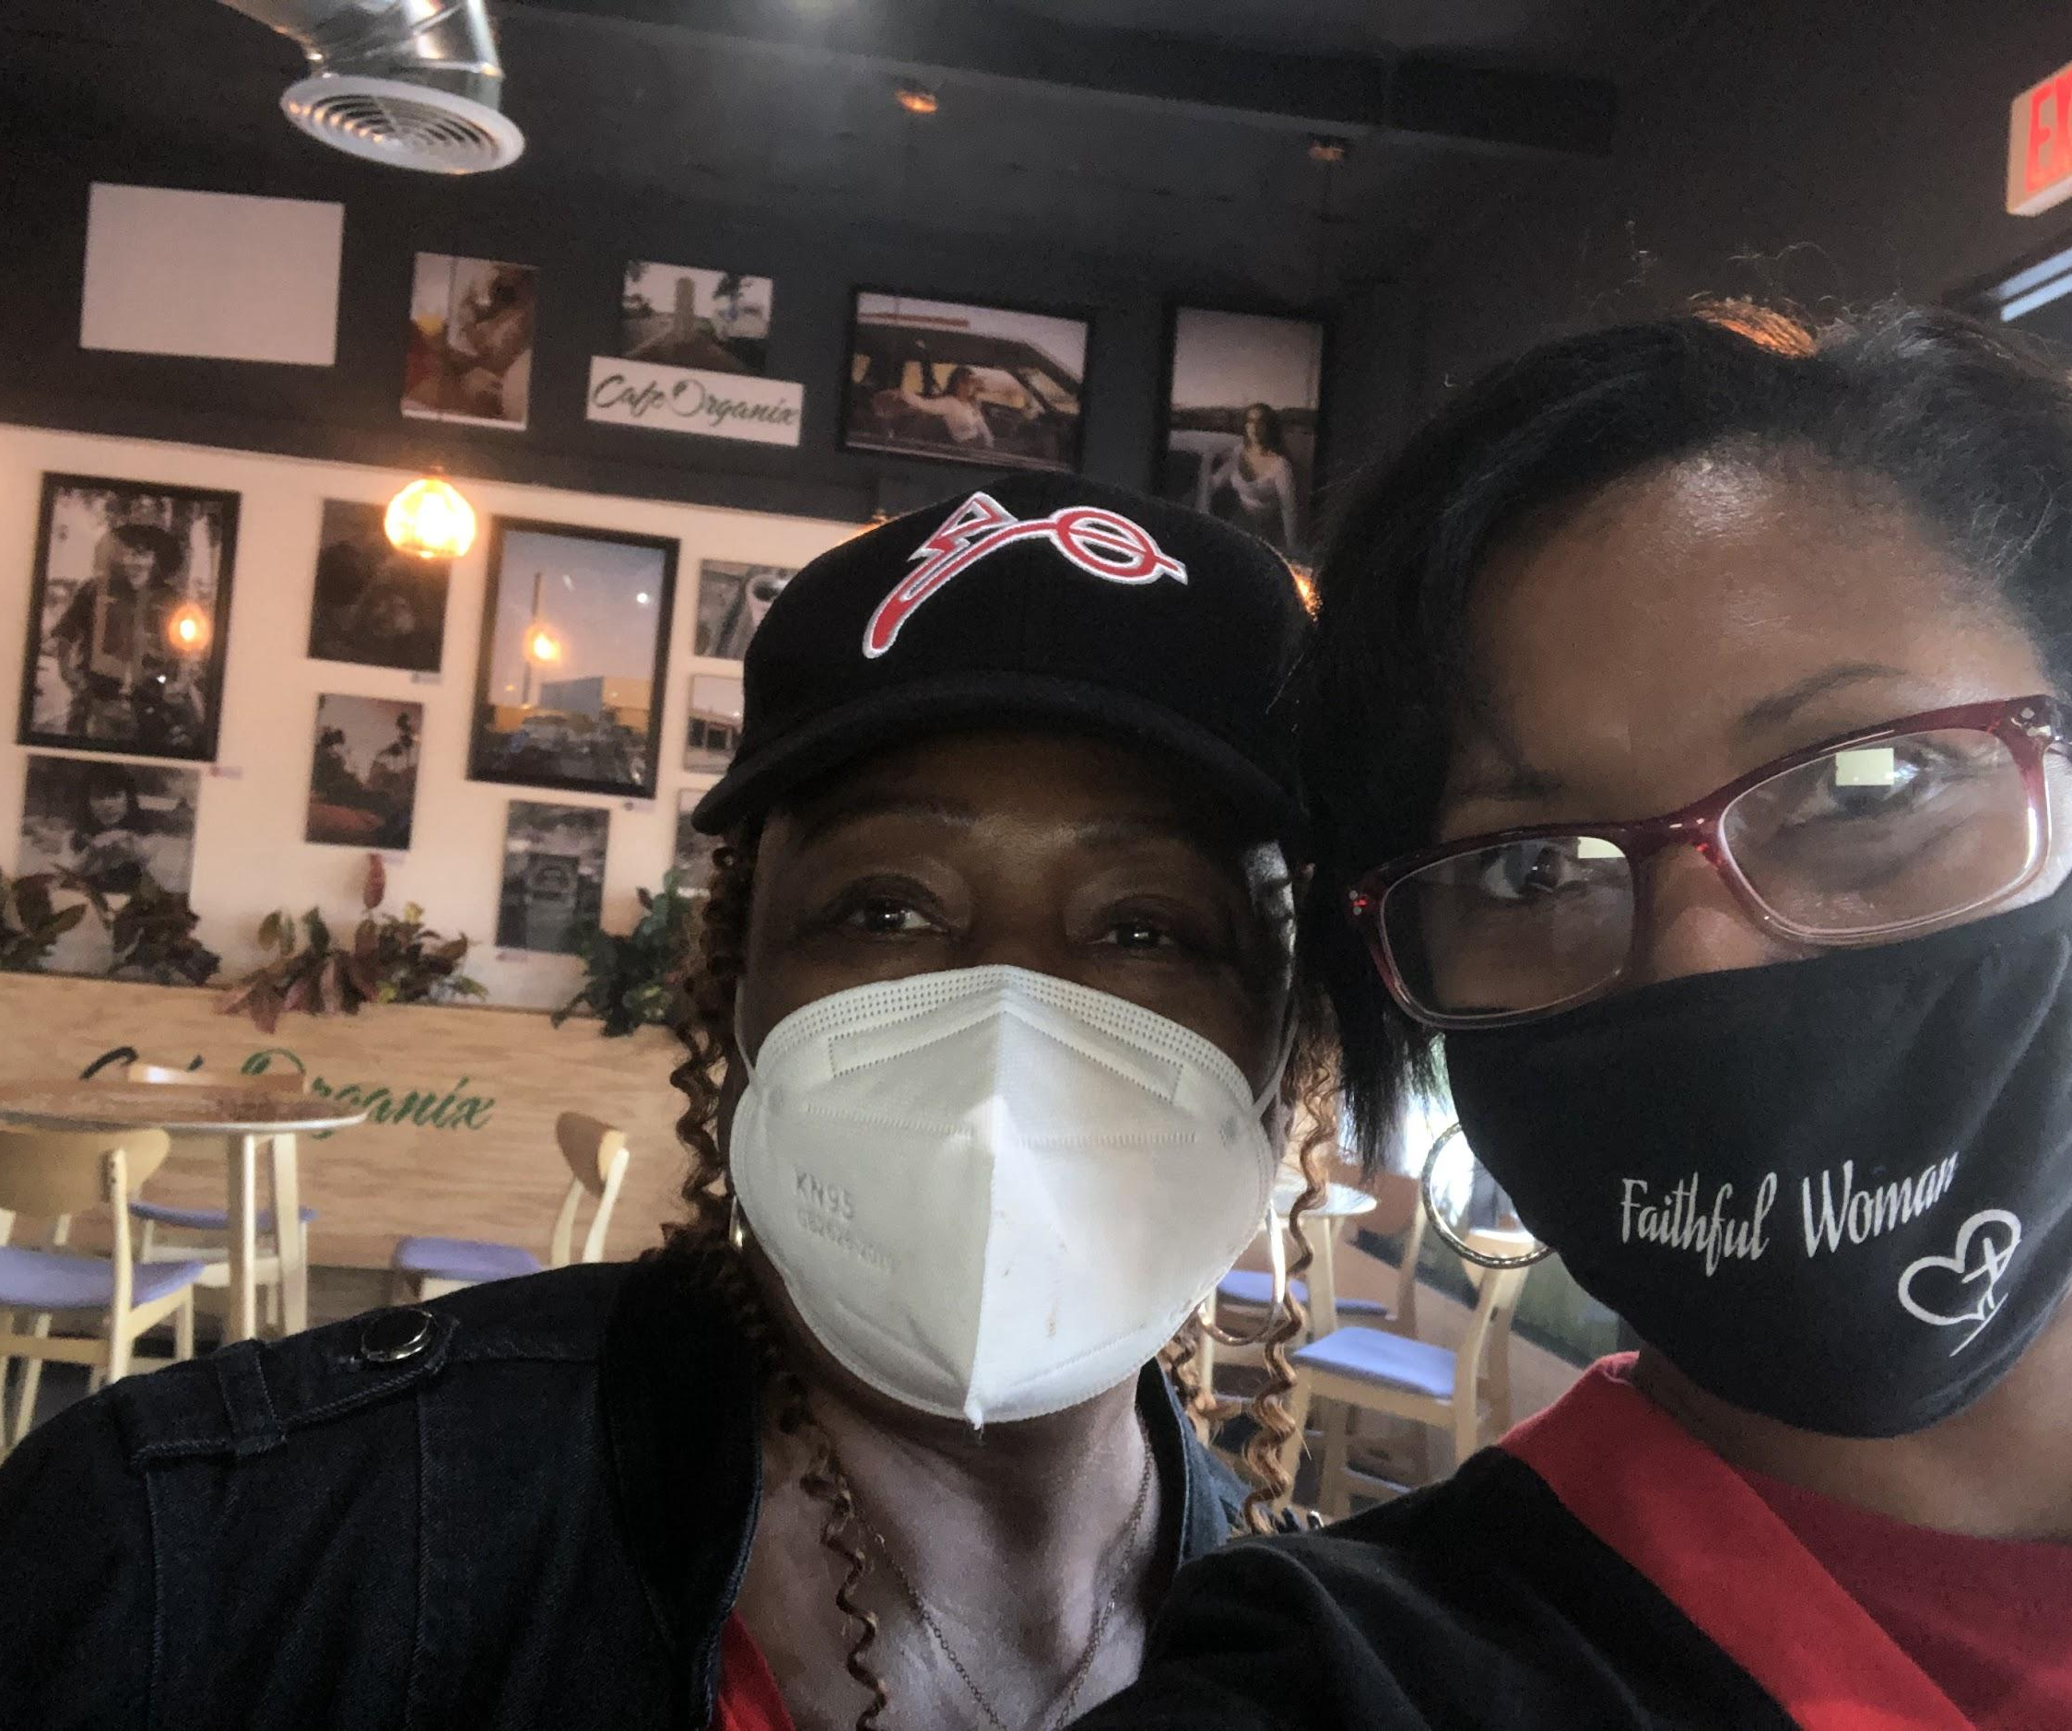
CAFE ORGANIX
We recirculated our dollars by supporting black owned businesses!

Slide 24
Notes:
Our collaboration with the Economic Development Committee was highlighted by the organization of our very own SBRAAC Black Book featuring black owned business that chapters members personally experienced and recommended.

Slide 25
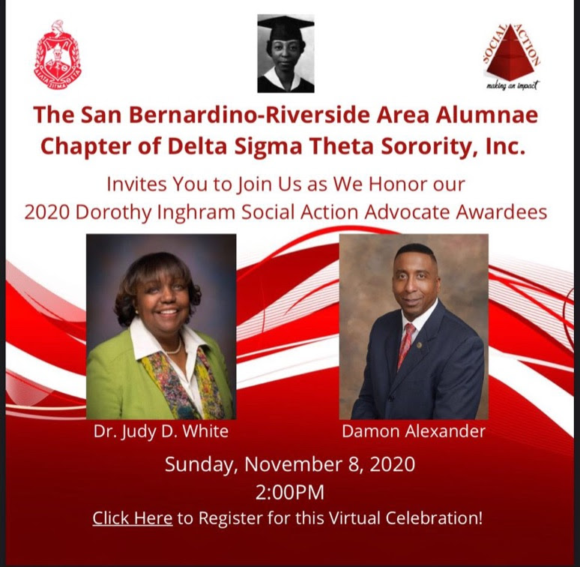
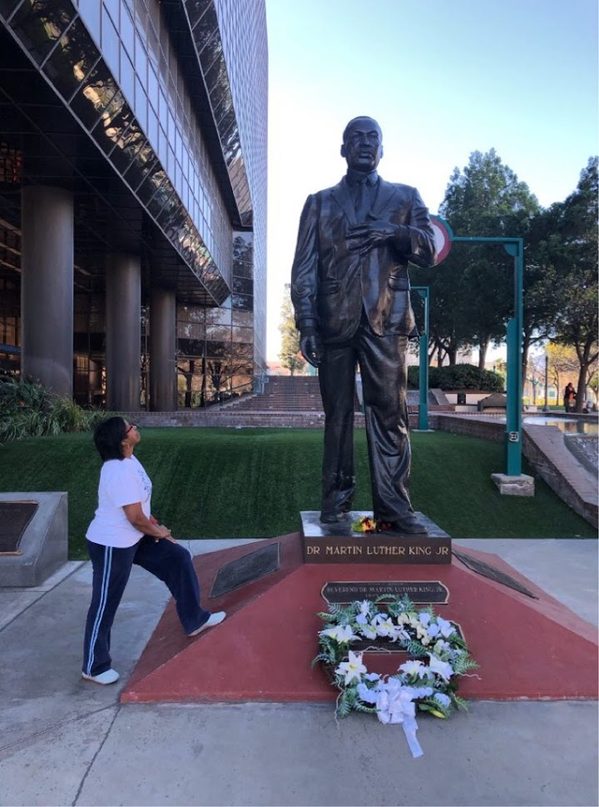
We honored our 2020
Social Action Advocates!

Slide 26
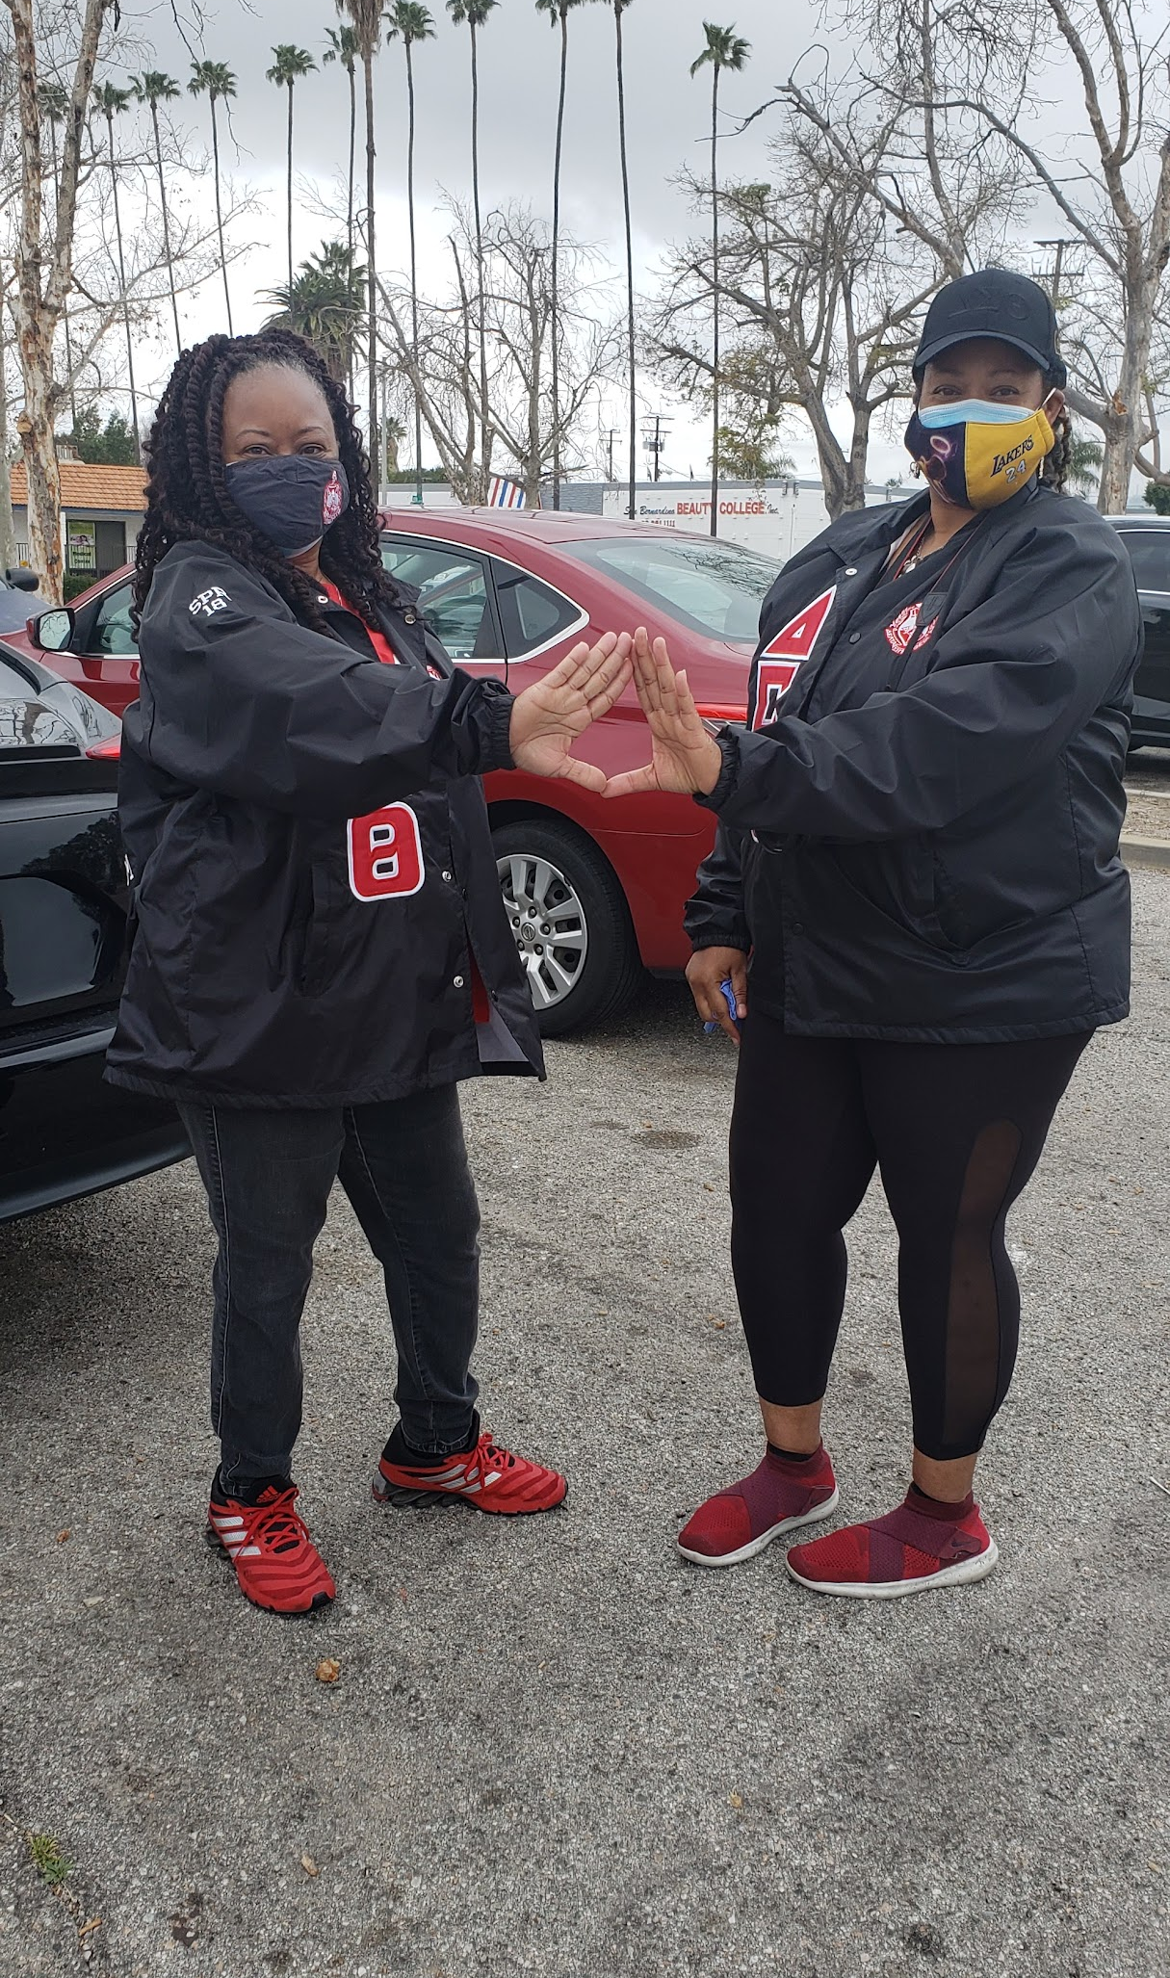
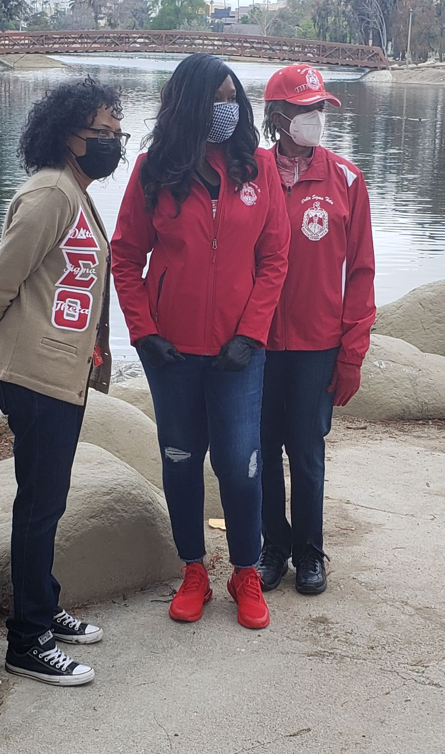
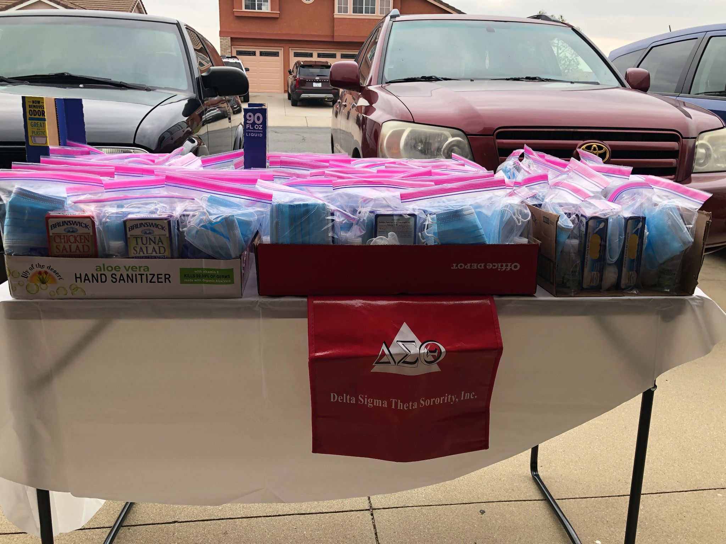
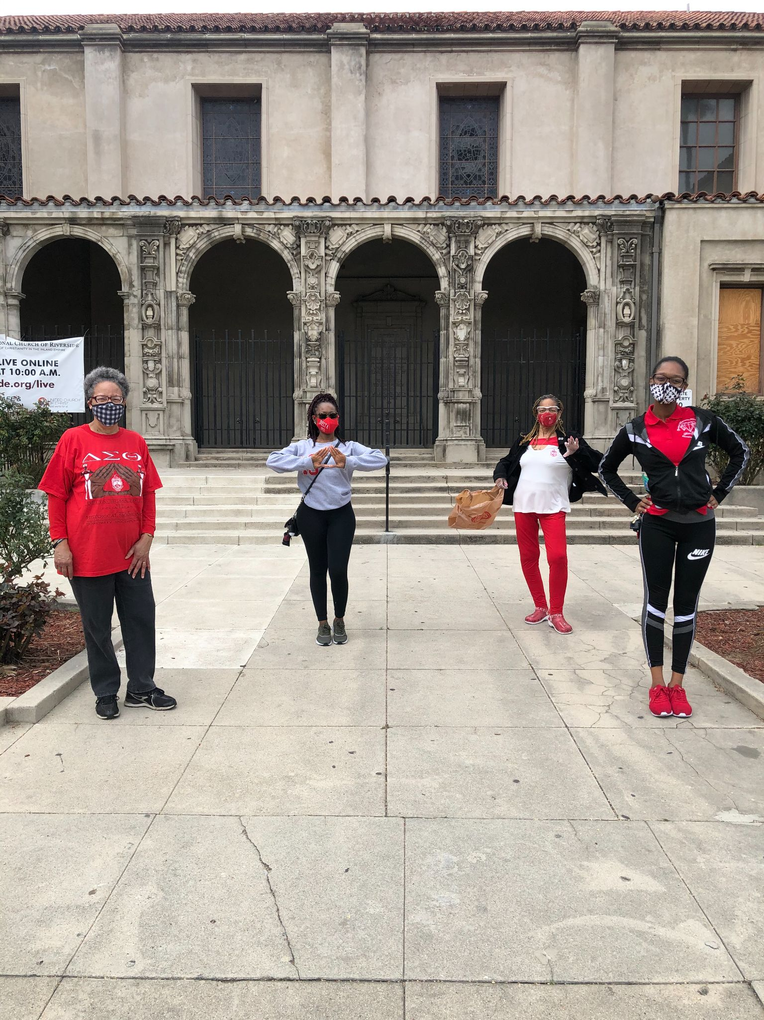
Farwest Regional Community Service Initiative Day - March 20, 2021
Our Delta GEMS and Sorors from Upsilon Gamma collegiate chapter joined our entire chapter as we provided 225 survival kits to the homeless brothers and sisters in our parks
at Seccombe Lake in San Bernardino and Fairmount Park in Riverside.

Slide 27
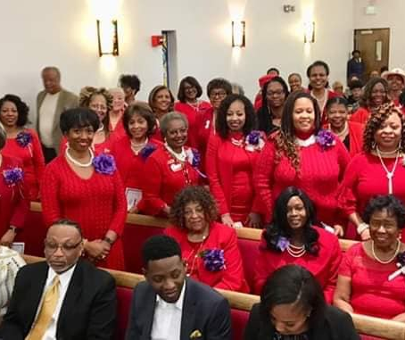
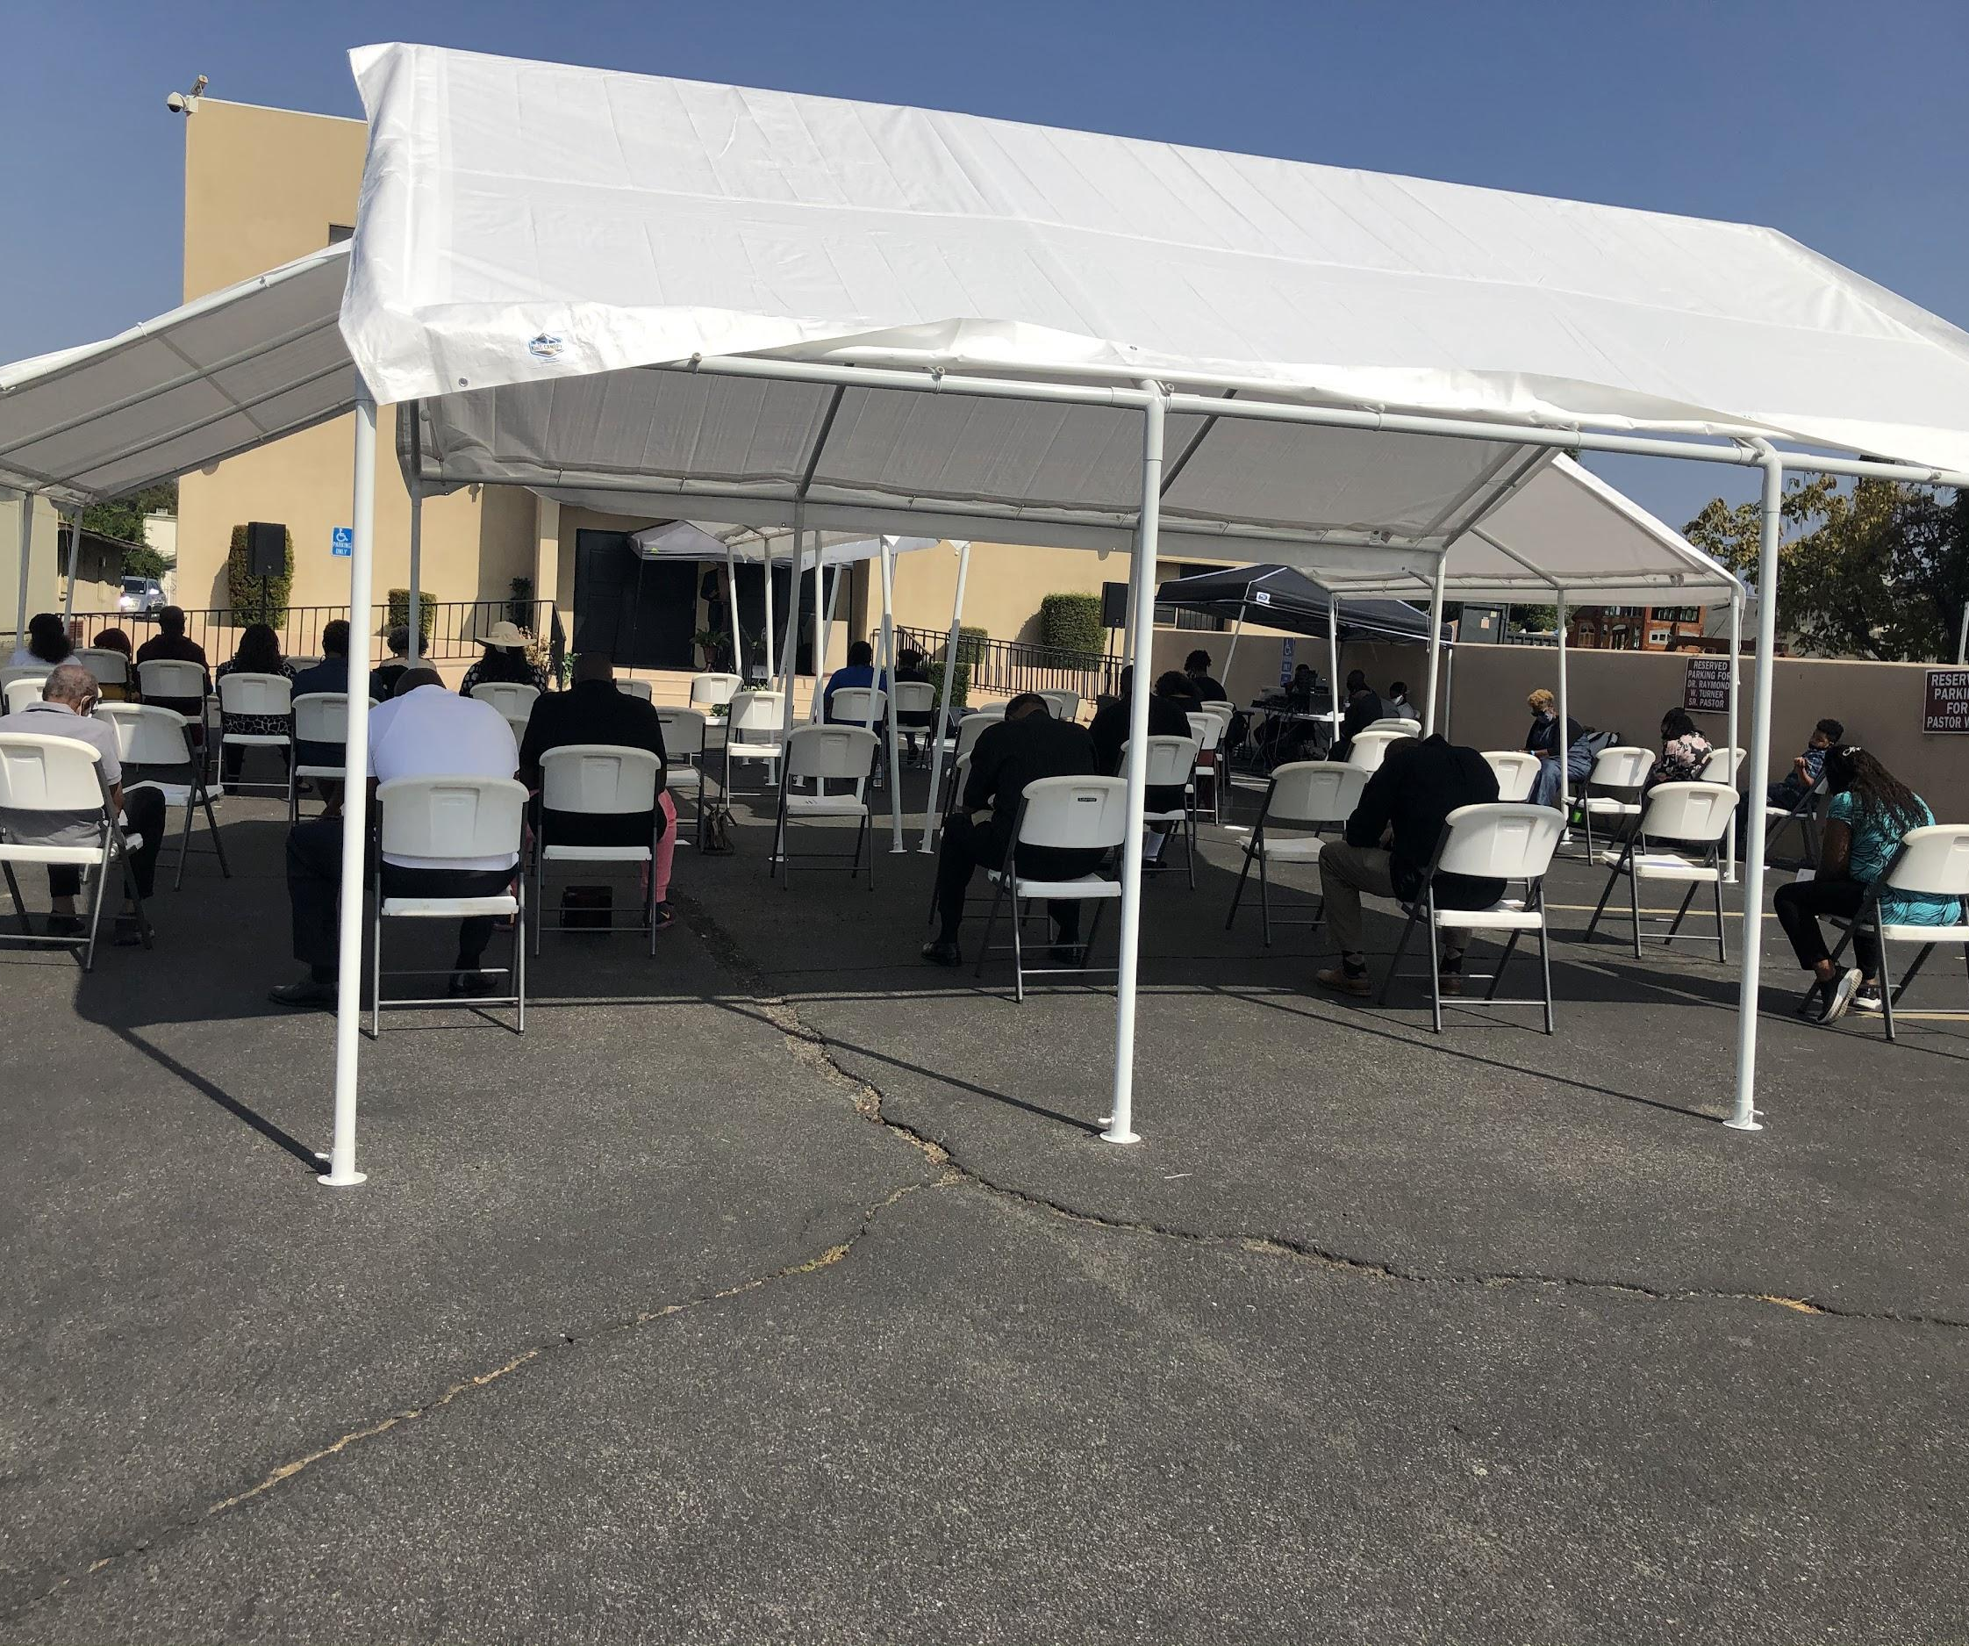
During Covid-19 we
worshipped outside.
Before Covid-19 we worshipped together!
Notes:
In collaboration with the Membership committee we celebrated All Day with Delta starting with attending the virtual worship service at Mt. Rubidoux Seventh Day Adventist Church, followed by a virtual cooking class and chapter meeting.

Slide 28
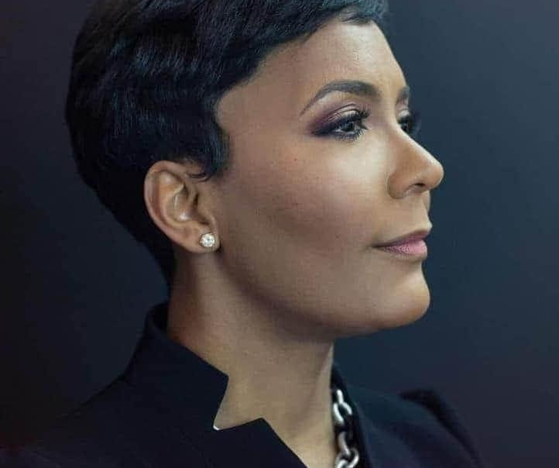
Oscar Nominee Soror Andra Day
Atlanta Mayor, Soror Keisha Lance Bottoms
Deltas graduated from West Point!
We celebrated excellence where every it was found!!!

Slide 29
We ushered in a new administration!
Notes:
We did that!!!

Slide 30
Finally, we gathered to celebrate Political Activism, Professional Achievement and Servant Leadership

